Slide 1
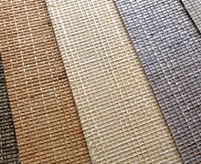
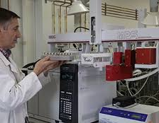
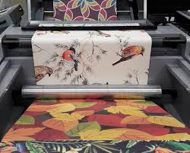
Ministry of Investment,
Industry and Trade of the Republic of Uzbekistan
Production of wallcoverings
Project overview
Financing
100 mln USD
Business model: manufacturing facility with production capacity of 5 mln rolls of wallcovering per year
Project scope
Construction of wallcoverings manufacturing plant
Production process for wallcoverings
Incentives
Infrastructure development at state cost* (project cost exceeding 15 mln USD)
Across the Republic, 27 FEZs offer tax breaks on land, property, water, CIT.
(CIT - applied for investments over 3 mln USD)
Design and Concept Development
Material
Selection
Ink and Coating Preparation
Printing and Production
Finishing
Exemption from taxes
3 years if investment is between 0,3 – 3 mln USD
5 years if investment is between 3 – 5 mln USD
7 years if investment is between 5 – 10 mln USD
10 years if investment is over 10 mln USD
Project description
Domestic market
Existing 5 neighbor markets
Russia, Europe, Middle East markets
5 production line
~170 employees
Capability to produce various sizes and design
Infrastructure
Gas 12 cents/m³
Electricity 7 cents/kWh
Water 20 cents/m³
Production and trade volume of wallcoverings (2024)
Production
Export
Import
Consumption
Consumption (CA)
50 thsd tons
2,6 thsd tons
(14mln USD)
26 thsd tons
(75 mln USD)
75 thsd tons
210 thsd tons

Slide 2
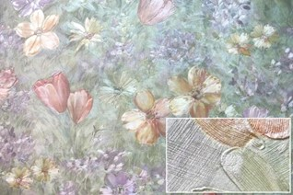
We invite to invest in wallcoverings manufacturing in Uzbekistan
Ministry of Investment,
Industry and Trade of the Republic of Uzbekistan
Leading companies manufacturing wallcoverings
Project overview
Trade agreements
Types of wallcoverings
Local companies
GSP+ agreement allows to export to EU at reduced or zero tariff for 6 200 products.
CIS Free Trade Agreement creates more integrated and open market with CIS countries.
Wallpaper
Location
Vinyl
Navoi region
Foreign companies
Fabric
Navoi region
Size | 110 800 km²
Population | 1,1 million
Metallic Foils
Availability of labor in building materials industry
Local wallcoverings manufacturers can benefit from:
- Growing residential construction sector
- Availability of skilled & unskilled labor
- Building on existing infrastructure and distribution networks
- Infrastructure development at state cost*
- Incentives: Free economic zones offer tax breaks on land, CIT, water
Higher education institutions: 28
Faculties of higher education: 36
Number of graduates: 3 000

Slide 3
On the strategic international logistics corridor
Ministry of Investment,
Industry and Trade of the Republic of Uzbekistan
Tallin
Sankt-Peterburg
Riga
Latvia
Moscow
Klaipeda
Hamburg
Minsk
Berlin
Brest
Povorina
Essen
Lviv
Kyiv
Paris
Chop
Volgograd
Kandiagash
Aktogay
Astraxan
Beyney
Saksaulskaya
Ulan-Bator
Osh
Bayangal-Mangal
Mersin
Malatya
Saraxa
Mazar-i-Sharif
Kashgar
Xirat
Afghanistan
Peshavar
Iran
Pakistan
Bandar-e-Abbas
Chakhbahar
Karachi

Slide 4
Excellent air connectivity from Tashkent and other Uzbek airports
Ministry of Investment,
Industry and Trade of the Republic of Uzbekistan
New York
A visa-free policy for tourists from 90 countries
Diverse range of 59 carriers in Uzbekistan’s airport
11 airports across the Country, the main airports are Tashkent, Samarkand and Bukhara

