Slide 1
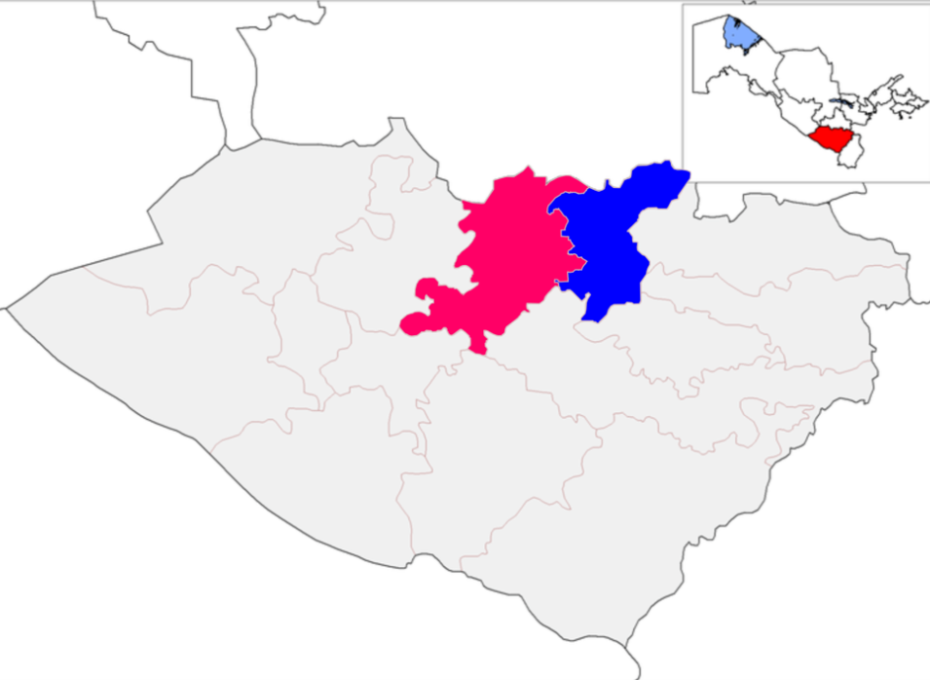
Promising investment projects of the Kukdala District, Kashkadarya Region
Kukdala District
Indicators of Proposed Projects
A district in the Kashkadarya Region.
Established on April 19, 2022.
Administrative center – the town of Yettitom.
Area – 171,000 hectares.
Population – 192,000.
Climate – continental and arid, occasionally subtropical.
Number of projects
14 projects
IRR average
22,5 %
Total cost
$ 157,3 mln.
New jobs
1935
Kashkadarya Region
Kukdala District
New projects
Why the region is an attractive destination for investment
High Investment Potential: The region holds strong potential in the fields of industry, energy, agriculture, and tourism.
Abundant Natural Resources: The area is rich in mineral and hydrocarbon raw material reserves, enabling the successful implementation of projects in the fuel and energy sector, chemical industry, construction materials production, and food processing.
Skilled Workforce: The regional administration is focused on providing practical support and legal protection for foreign companies engaged in investment activities in the area.
Development of Livestock Farming: The region has recently imported 62,000 sheep and 10,000 cattle. A livestock cluster and a poultry farm are currently being established.
Tourism Development: Investment opportunities are available in the Miraki and Maidanak areas. Plans include the construction of 200 hotels and 1,000 retail outlets.
Ambitious Investment Targets: Kashkadarya Region aims to attract $3.5 billion in investments and increase its export volume to $1 billion by 2025.
Kashkadarya Region aims to attract $3.5 billion in investments and increase its export volume to $1 billion by 2025.
Textile industry
Agriculture
4 projects
$47,0 mln.
5 projects
$44,3 mln.
Construction industry
Food industry
3 projects
$55,0 mln.
5 projects
$11,0 mln.
Proposals for placement of projects
«IT-Park » branch
«Kukdala » SIZ
Newly established
special industrial zones
Land, property, water tax benefits
Солиқ имтеёзлари
3 years (Investment
0,3 – 3 mln. USD)
5 years
(Investment
3 – 5 mln. USD)
7 years
(Investment
5 – 10 mln. USD)
10 years
(Investment
10 mln. USD)
Examples of Investment Projects
IT Park branch. In a building with an area of 5,072 square meters, MAAB Innovation and other companies have established operations, providing education and training for local youth in the fields of information technology and innovation.
Development of Organic Farming. Opportunities are being created to expand the production of organic products in line with the introduction of advanced technologies and the goals of developing agriculture in the region.

Slide 2
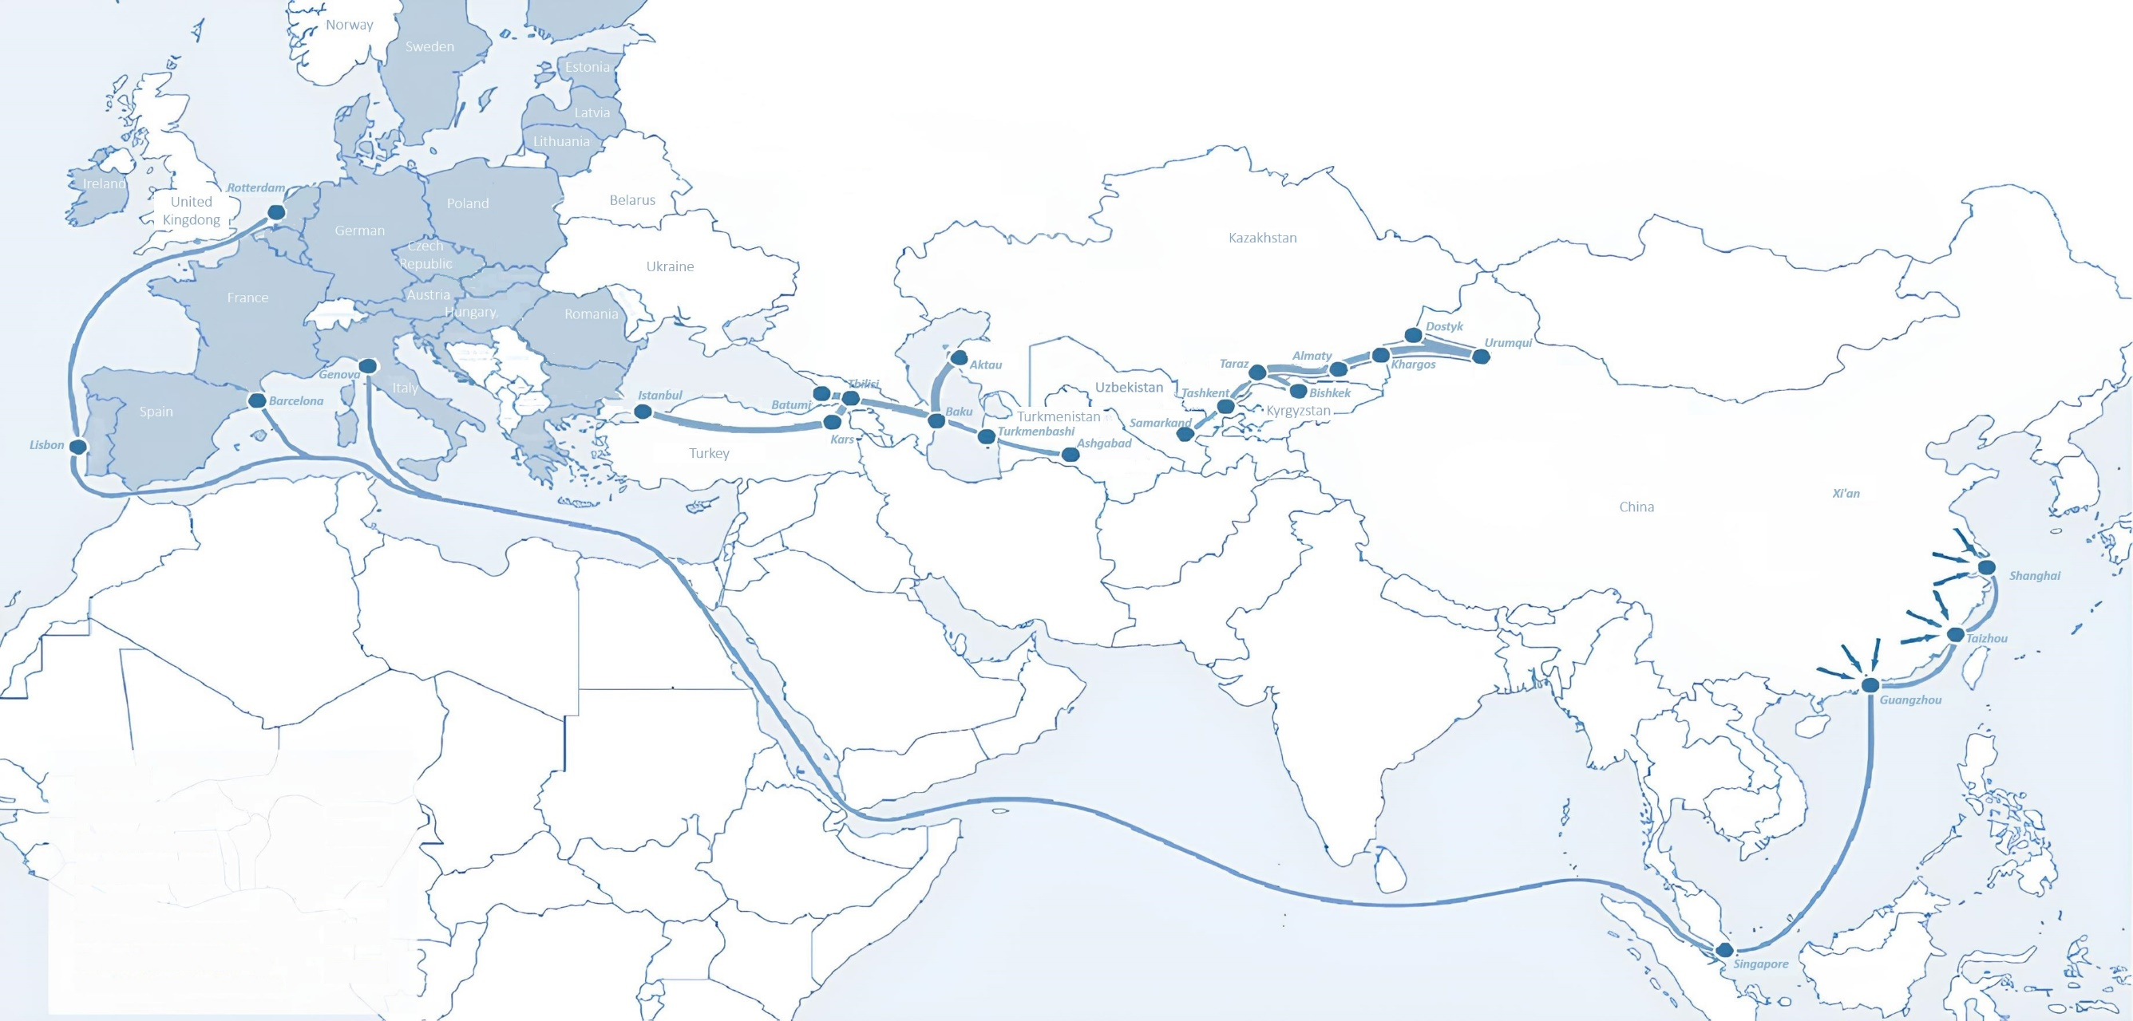
International Logistics and Transport Corridors
Tallin
Sankt-Peterburg
Riga
Latvia
Moscow
Klaipeda
Hamburg
Minsk
Berlin
Brest
Povorina
Essen
Lviv
Kyiv
Paris
Chop
Volgograd
Kandiagash
Aktogay
Astraxan
Beyney
Saksaulskaya
Ulan-Bator
Osh
Bayangal-Mangal
Mersin
Malatya
Saraxa
Mazar-i-Sharif
Kashgar
Xirat
Afghanistan
Peshavar
Iran
Pakistan
Bandar-e-Abbas
Chakhbahar
Karachi

Slide 3
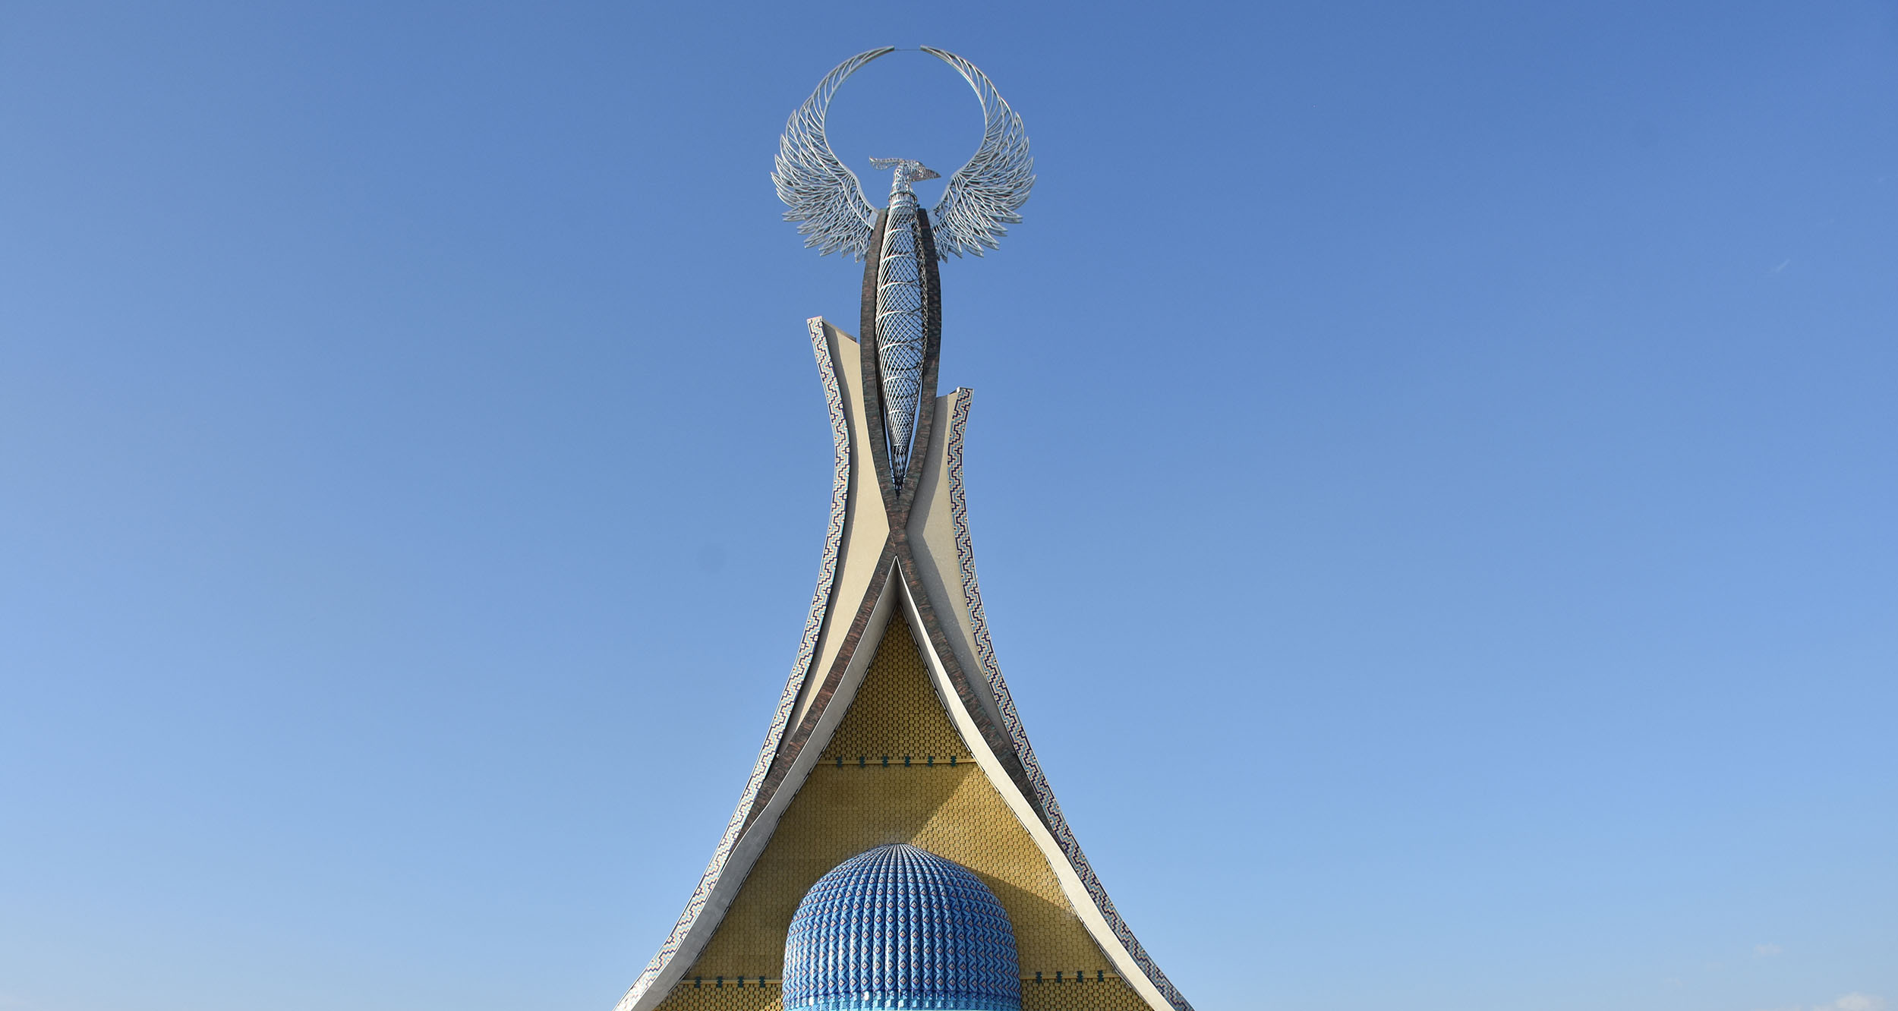
New Investment
Project Proposals

Slide 5
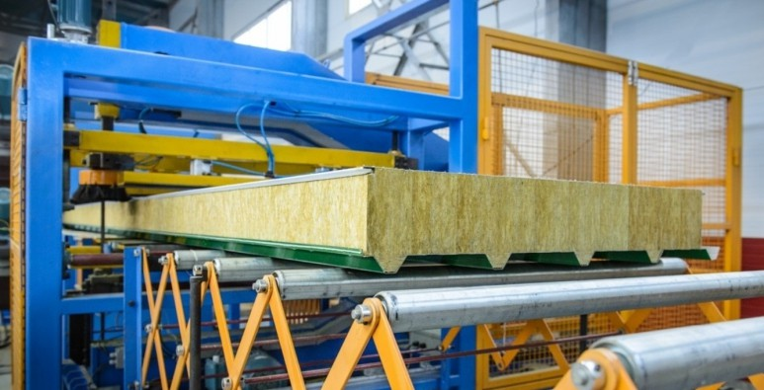
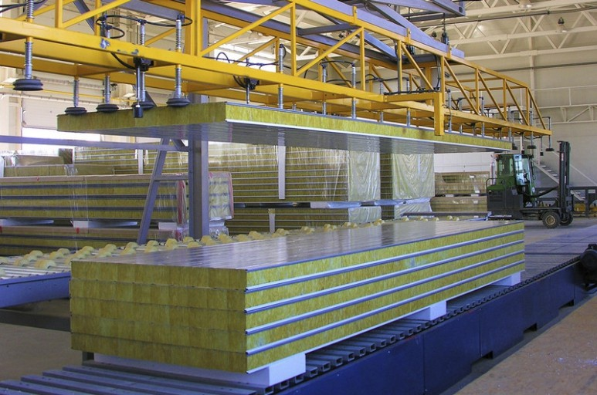
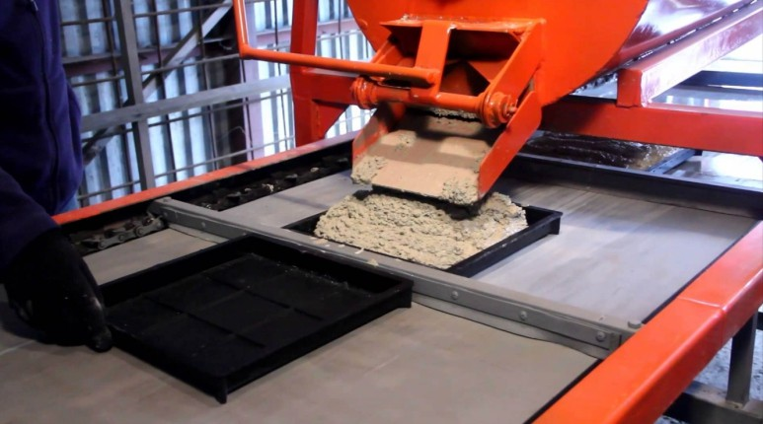
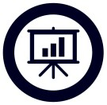
INVESTMANT OFFER
M a n u f a c t u r e o f t i l e s a n d s a n d w i c h p a n e l s
Project location:
Kukdala district
Project cost:
15.0 million dollar
Production capacity (per year):
900 thousand m²
IRR (fin):
11,0 %
NPV (fin):
482 083,0 dollar
Project payback:
5,0 years
Jobs:
300 people
Project implementation period:
12 month

Slide 6
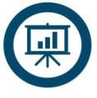
INVESTMENT OFFER
Project location:
Kukdala district
Project cost:
50 , 0 MILLION DOLLARS
Production capacity (per year):
300 000 KG
IRR (FIN):
18,0 %
NPV (FIN):
691 257, 0 DOLLARS
Project payback:
5 YEARS
Jobs:
20 PEOPLE
GROWING OF QUALITY SEED VARIETIES FOR POLICE CROPS

Slide 7
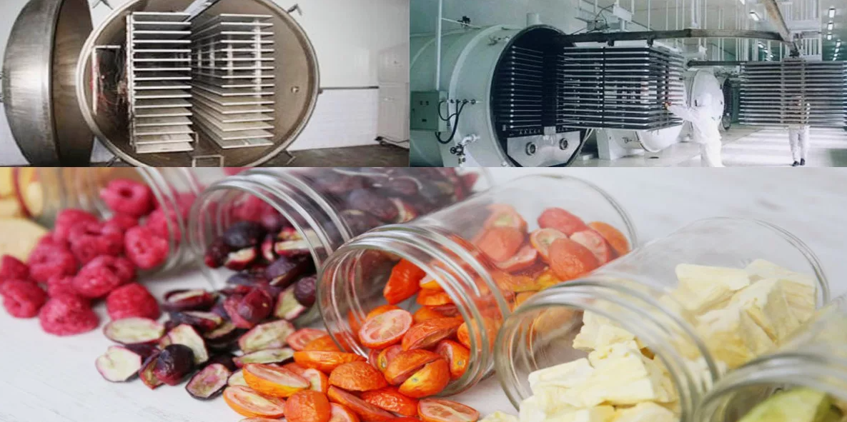
Export of products through processing, freeze-drying and packaging of melon products
INVESTMENT OFFER
Project cost:
$6.0 million ($1.8 million own resources,
$4,2 million bank loans)
Production capacity (per year):
Project location:
Kukdala district
Drying of agricultural products by sublimation method - 11000-13000 tons, packaging - 2.7-4.8 thousand tons, drying - 7000 tons
IRR(fin):
12,0%
NPV (fin):
487,0 thousand dollar
Annual market need:
100,0 thousand ton
Project payback:
7 years
Jobs:
100 people
Project implementation period:
6 months

Slide 8
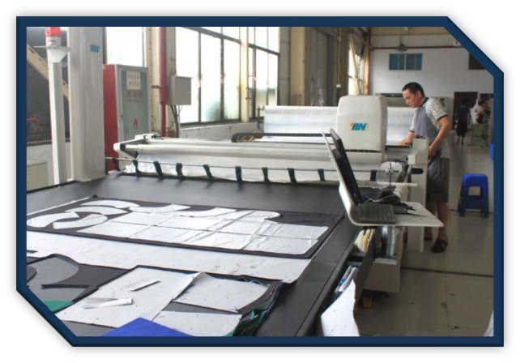
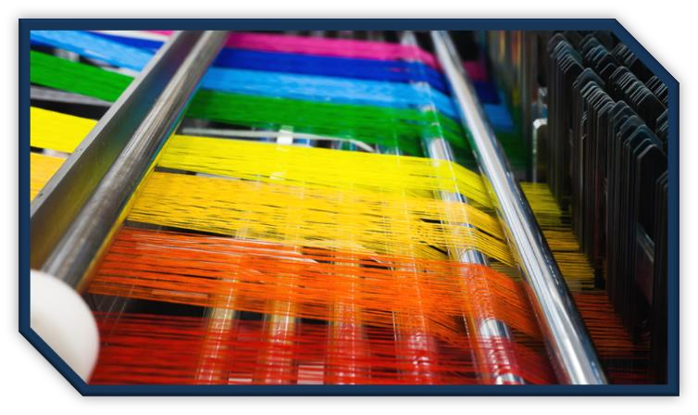
Cocoon development, cocoon processing through silk fiber and silk fabrics organization of production
INVESTMENT OFFER
Project cost:
Project location:
Kukdala district
$5,0 million ($1,5 million own resources,
$3,5 million bank loans)
Production capacity (per year):
Cotton fiber 8800ton. cotton lint 600.0 tons. cotton waste 160.0 tons
IRR(fin):
23,8%
NPV (fin):
550,0 thousand dollar
Annual market need:
20000 ton
Project payback:
7 years
Jobs:
189 people
Project implementation period:
9-12 months

Slide 9
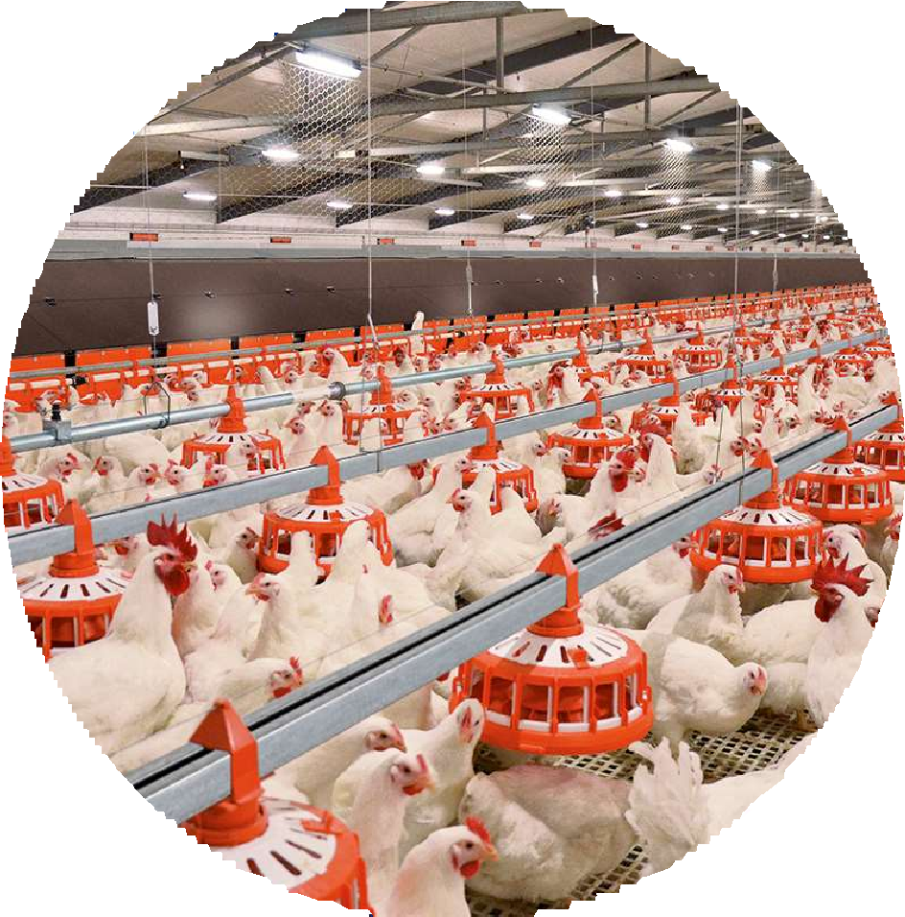
Name of the project
POULTRY COMPLEX
Financial evaluation of the project:
Project cost:
Project Location:
17%
$407 637
$0,8 mln Own funds
IRR (fin)
$2 400 000
Kukdala district
NPV (fin)
$1,6 mln bank loans
Comment
Key figures
Duration of the project
5 years
Revenue figures
U.S. dollars
Production capacity
1,500,000 kg per year
The launch of the project will make it possible to organize a poultry complex for the production of chicken meat and eggs on the territory of the Republic of Uzbekistan. The projected capacity of the enterprise at the initial stage will be more than 3,000 thousand pieces. eggs and 1,500,000 kg of poultry meat per year; The sale of products is planned for the domestic market of the Republic and further sales to neighboring countries.
1 year
2103 261
2 year
2581 043
Payback of the project
5.2 years
Jobs created
3 year
2648 348
60
4 year
2715 652
5 year
2761 043
TOTAL SALES NET PROFIT
Cumulative profit
2581 043
2648 348
2715 652
2761 043
1836 411
2323 447
629 609
285 213
879 396
1365 675
132 983
1 год
594 183
486 279
3 год
470 736
4 год
487 036
5 год
2 год

Slide 10
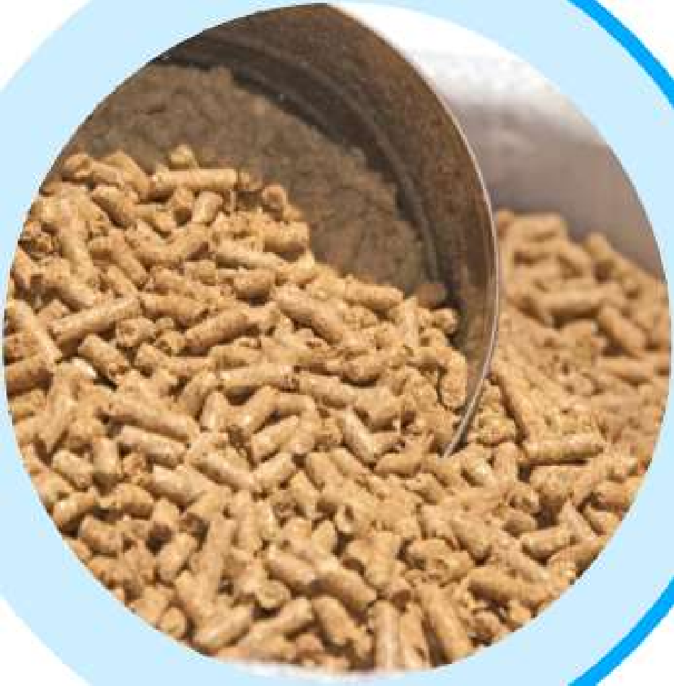
Name of the project
COMPLEX FOR THE PRODUCTION OF GRANULATED FOOD FOR ANIMALS
Financial evaluation of the Project cost: project:
Project Location:
15%
$172 889
IRR (fin)
$0,68 mln Own funds
Kukdala district
$2 289 000
NPV (fin)
$1,6 mln Bank loans
Comment
Key figures
Duration of the project
5 years
Revenue figures
U.S. dollars
Production capacity
5 952 tons per year
The launch of the project will make it possible to organize modern production for the production of granulated feed on the territory of the Republic of Uzbekistan. The projected capacity of the enterprise at the initial stage will be more than 4000 tons per year; The sale of products is planned for the domestic market of the Republic and further sales to neighboring countries.
1 year
1446 451
2 year
1684 224
Payback of the project
4.3 years
Jobs created
3 year
1783 296
39
4 year
1822 925
5 year
1862 554
TOTAL SALES
1282 400
1444 027
NET PROFIT
Cumulative profit
986 087
1018 957
751 382
1310 278
313 630
326 953
967 342
162 684
424 429
476 685
105 040
1 year
164 269
2 year
215 960
4 year
3 year
5 year

Slide 11
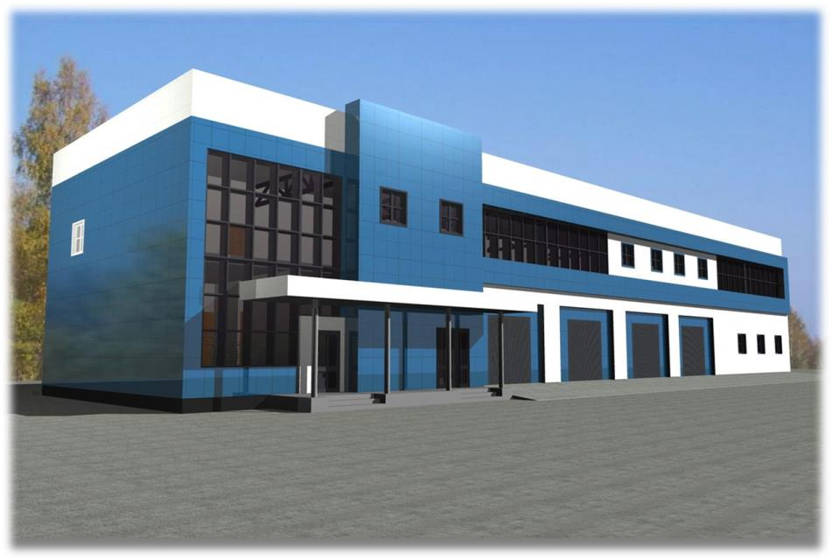
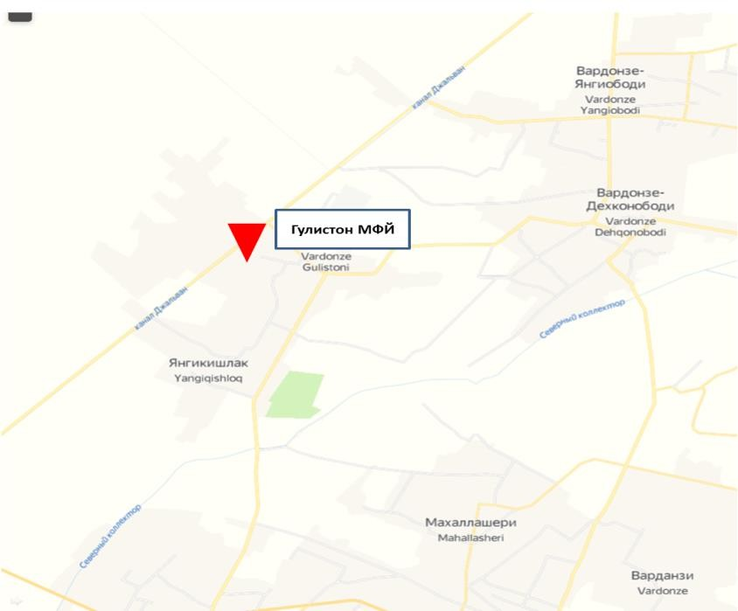
Organization of the production of women's clothes from silk fabric
Project location: Kukdala district
Production capacity
(per year):
150,0 thousand pieces
Jobs created:
74
Project payback: 5 years
Bank loans:
1,5 million
Own funds:
1,0 million
Project Implementation period:
12 months
Project cost:
$2,5 million
NPV (fin) 4,49 million
IRR (fin) 35,0%
3D drawing of the factory
Project location:

Slide 13
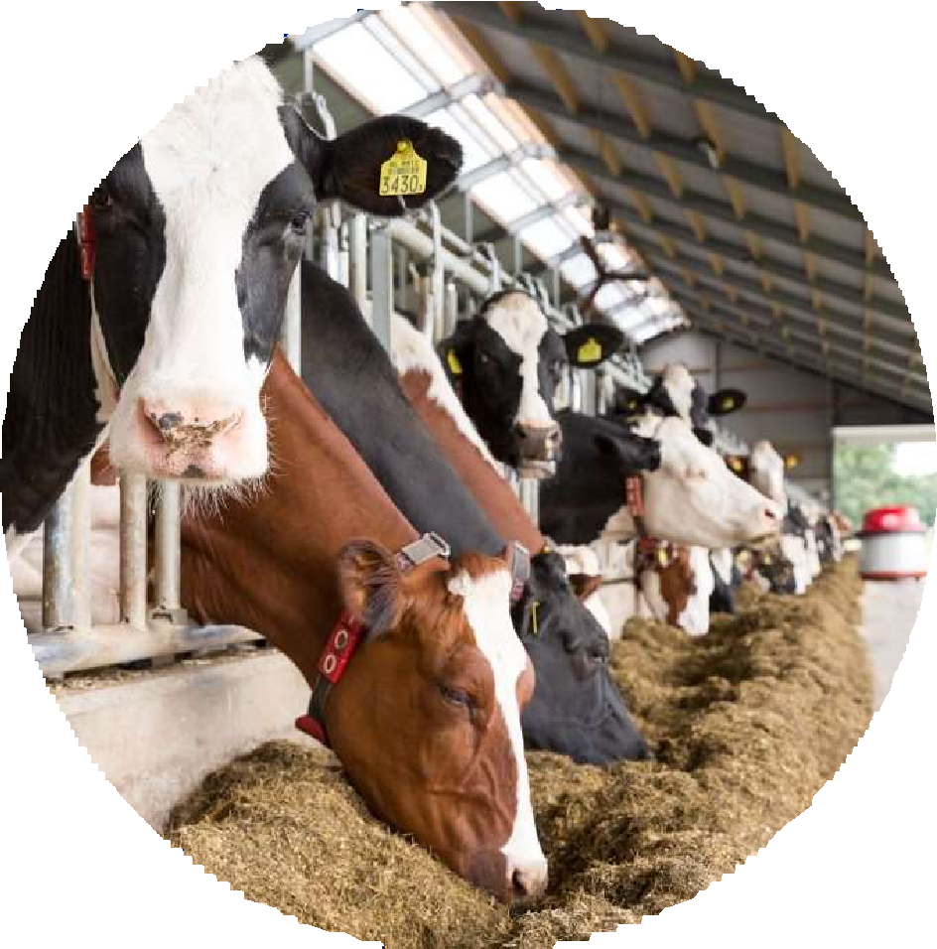
Name of the project
LIVESTOCK COMPLEX
Financial evaluation of the project:
Project cost:
Project Location:
13%
$914 309
Kukdala tumani
IRR (fin)
$6 618 130
$2,038 mln Own funds
NPV (fin)
$4,58 mln bank loans
Comment
Key figures
Duration of the project
7 years
Revenue figures
U.S. dollars
Production capacity
640 thousand kg per year
The launch of the project will make it possible to organize a modern production facility for the production of meat and dairy products on the territory of the Republic of Uzbekistan. The projected capacity of the enterprise at the initial stage will be more than 5800 tons per year; The sale of products is planned for the domestic market of the Republic and further sales to neighboring countries.
year
year
year
year
year
year
year
3788 609
4406 609
4460 348
4514 087
4621 565
4729 043
4836 522
Payback of the project
7.2 years
Jobs created
70
TOTAL SALES NET PROFIT
Cumulative profit
6757 666
4406 609
4460 348
4514 087
4621 565
5189 236
4836 522
3788 609
4729 043
1259 870
2781 103
3728 848
1187 572
1941 401
503 691 | 683 881 | 753 829 | 839 702 | 947 745 | 1460 388 | 1568 430
1 year | 2 year | 3 year | 4 year | 5 year | 6 year | 7 year

Slide 15
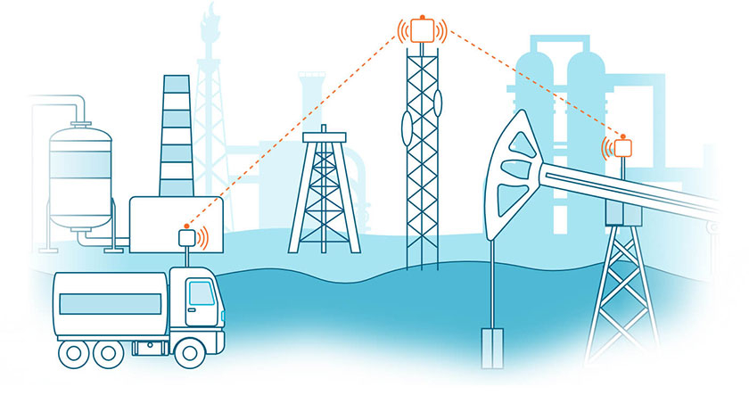
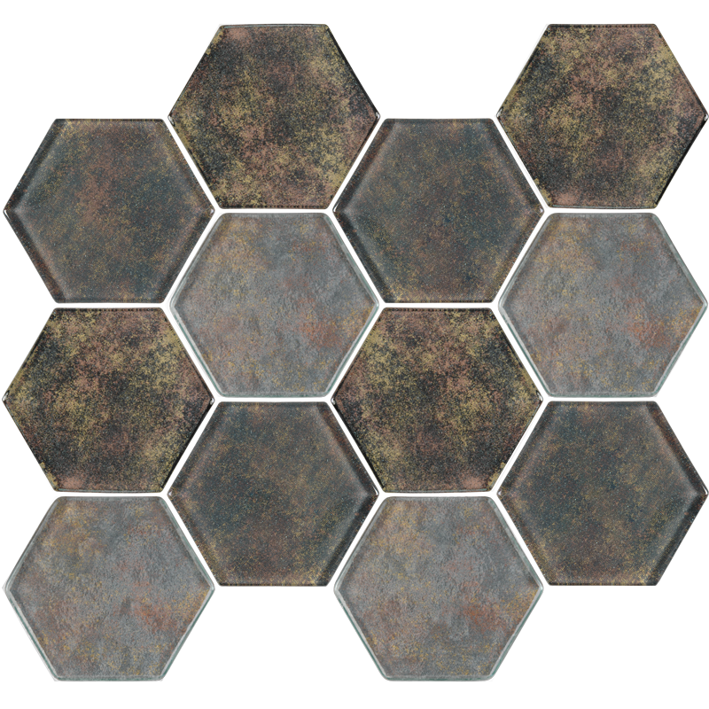
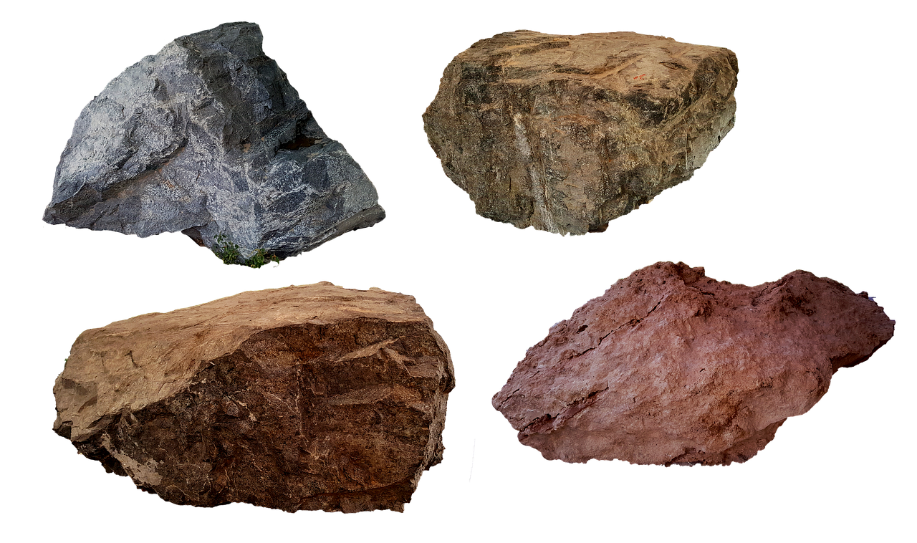
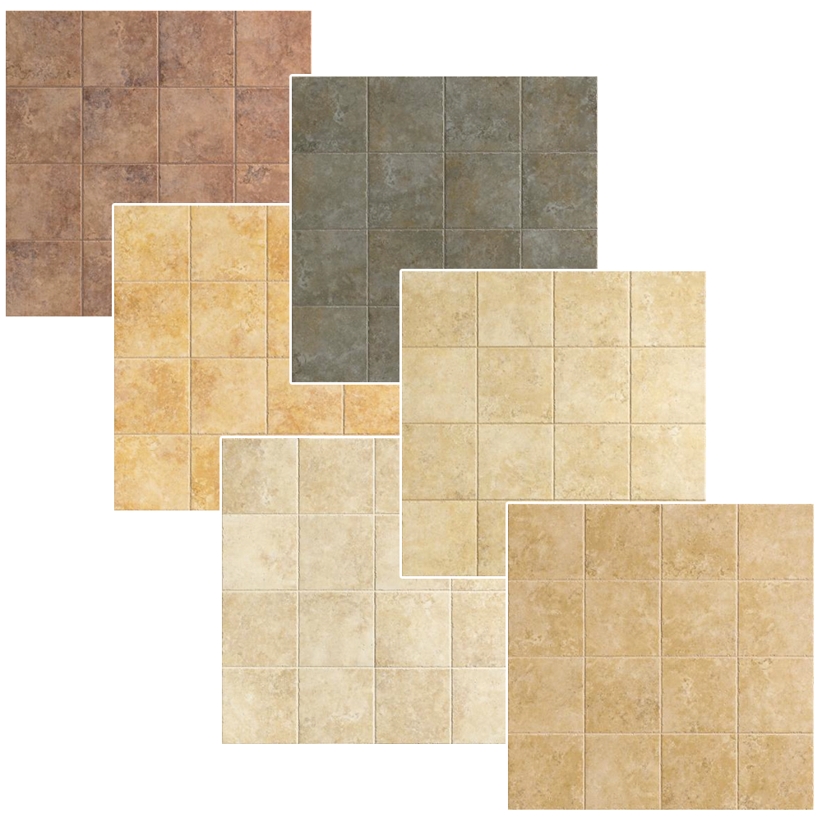
INVESTMENT OFFER
Dolomite trace ceramic tile production
Project location:
Kukdala district, Kashkadarya province
Project cost:
$22,4 million ($6,7 million own resources $15.7 million bank loans))
Production capacity (per year):
1,5 million sq m
IRR (fin) :
11%
NPV (fin) :
3,6 million dollar
Project payback:
5 years
Jobs:
60 people
Project implementation period:
14 months

Slide 16
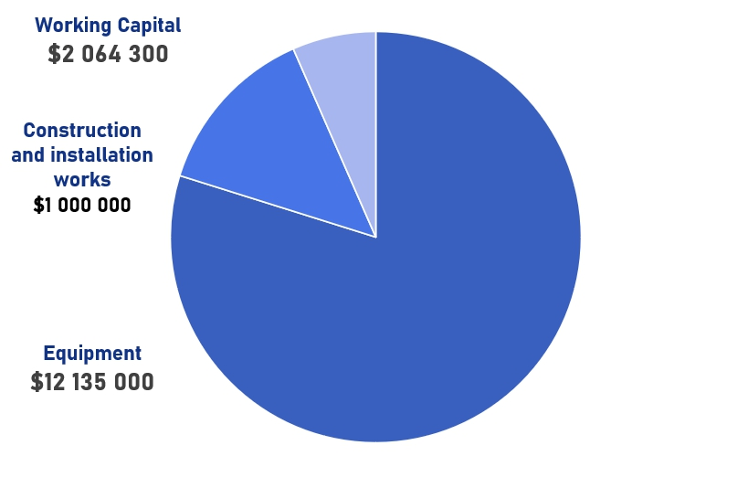
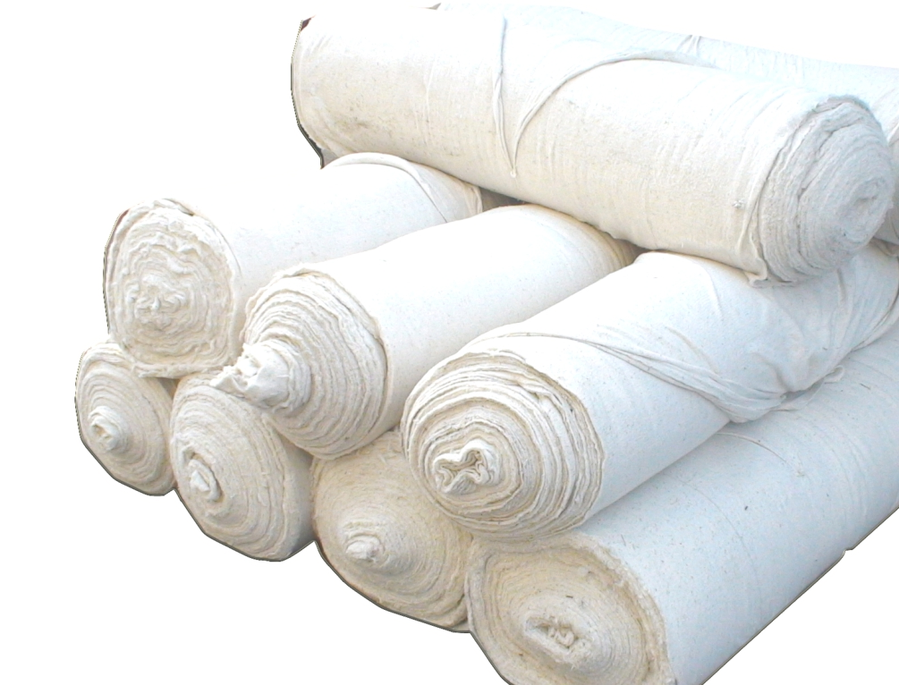

Slide 17
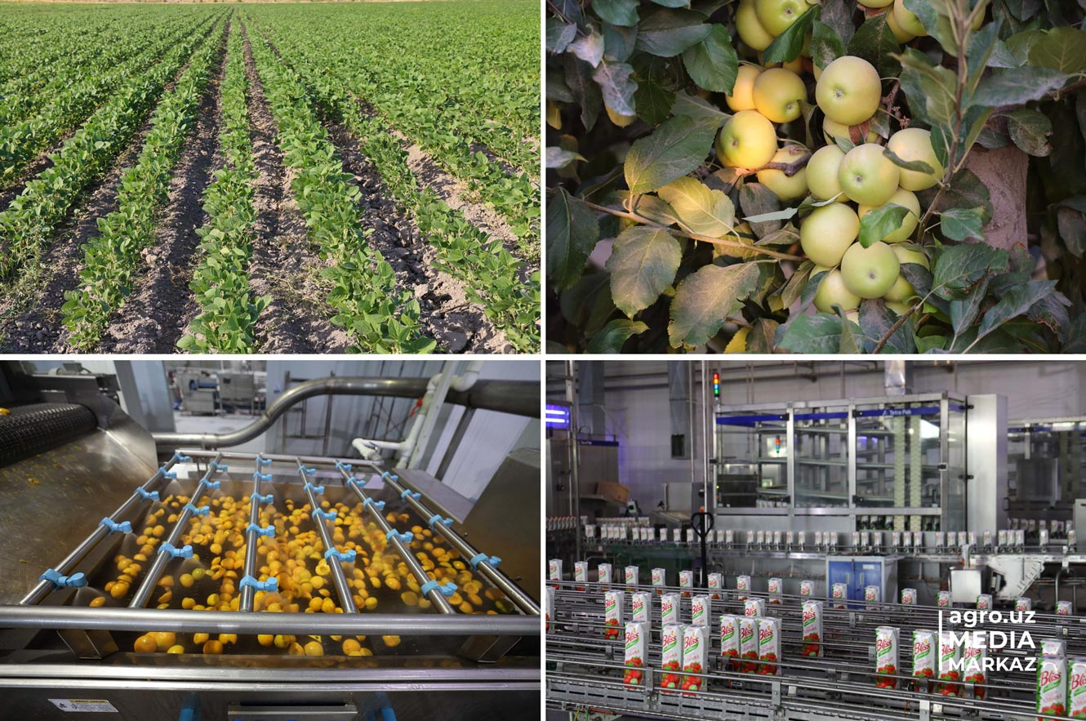
GROWING, PROCESSING, DRYING AND PACKAGING VEGETABLES AND AGRICULTURAL CENTER: ORGANIZATION OF A CENTER FOR THE RECEIVING, PACKAGING AND EXPORT OF AGRICULTURAL PRODUCTS
Kashkadarya region, Kukdala district
$12 million
112 640 ton
($3,6 million own resources,
$8,4 million bank loans)
30 ha
7 years
7%
60 people
$1 million
12 months

