Slide 1
Ministry of Investment,
Industry and Trade of the Republic of Uzbekistan
Privatization of LLC “UNG Medline”
Project overview
Business model:
Full ownership transfer through public auction. The enterprise operates on 2 ha, providing medical services to industrial workers and local communities.
Project scope
Privatization of 100% shares of LLC “UNG Medline”, a subsidiary of JSC “Uzbekneftegaz”, operating in healthcare and medical services
Investment terms:
Investor will acquire 100% ownership via public auction.
Timeline
2025
2026
Transfer of ownership to the investor
Public auction announcement and bidding process
Financing (estimated value)
$2-5 million (subject to auction results)
Location
Kashkadarya region
Advantages and Potential
High demand for healthcare services in industrial regions.
Potential for modernization with advanced medical technologies.
Stable client base from JSC “Uzbekneftegaz” employees.

Slide 2
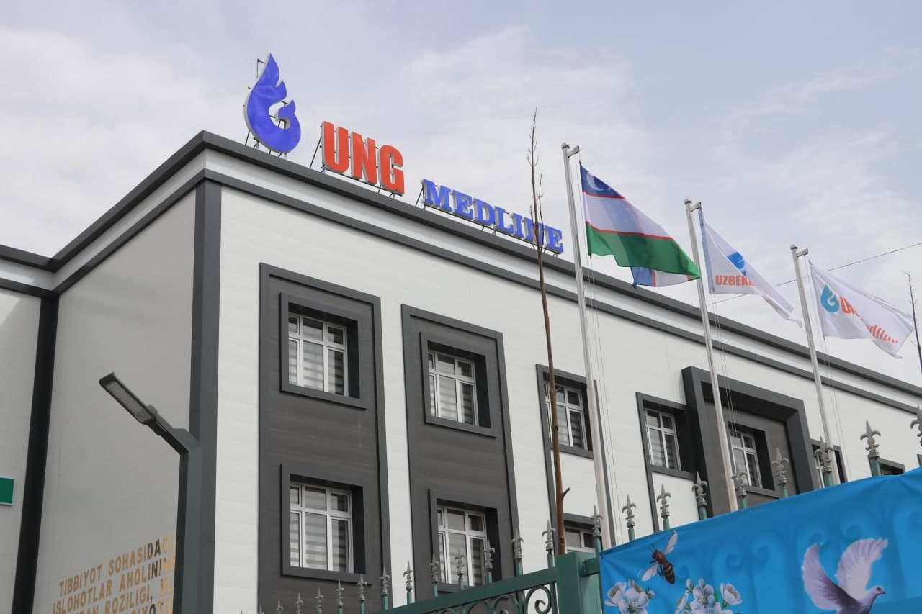
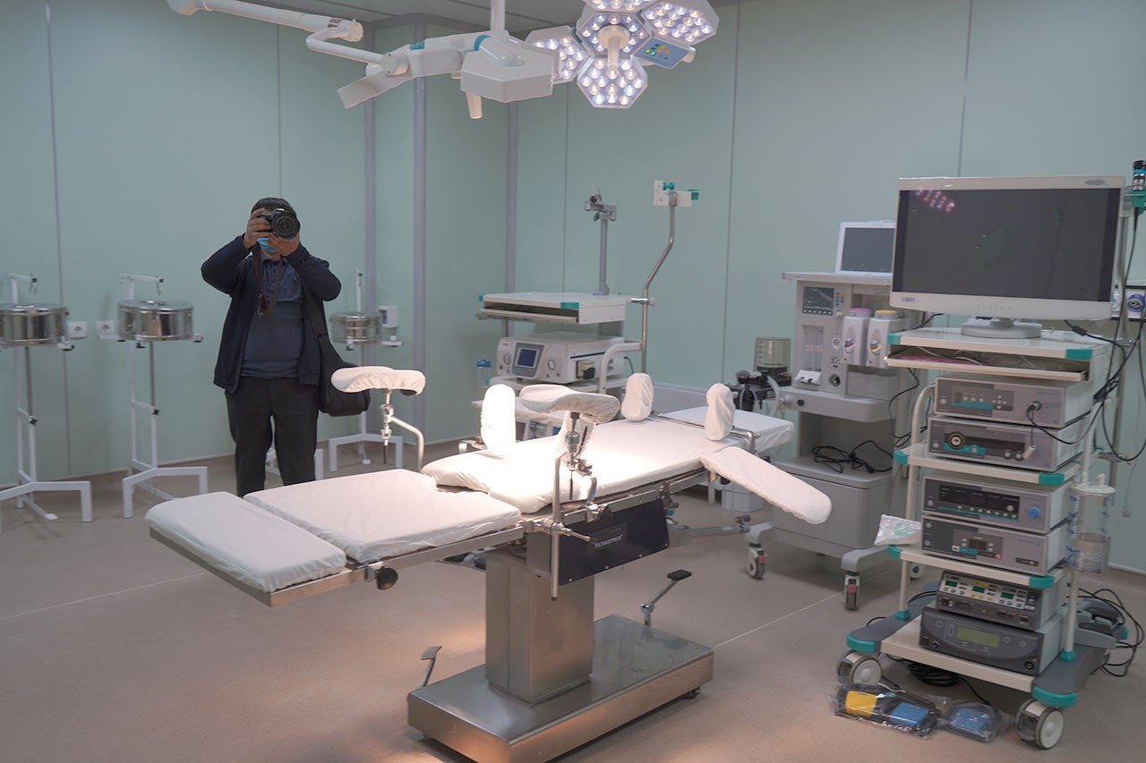
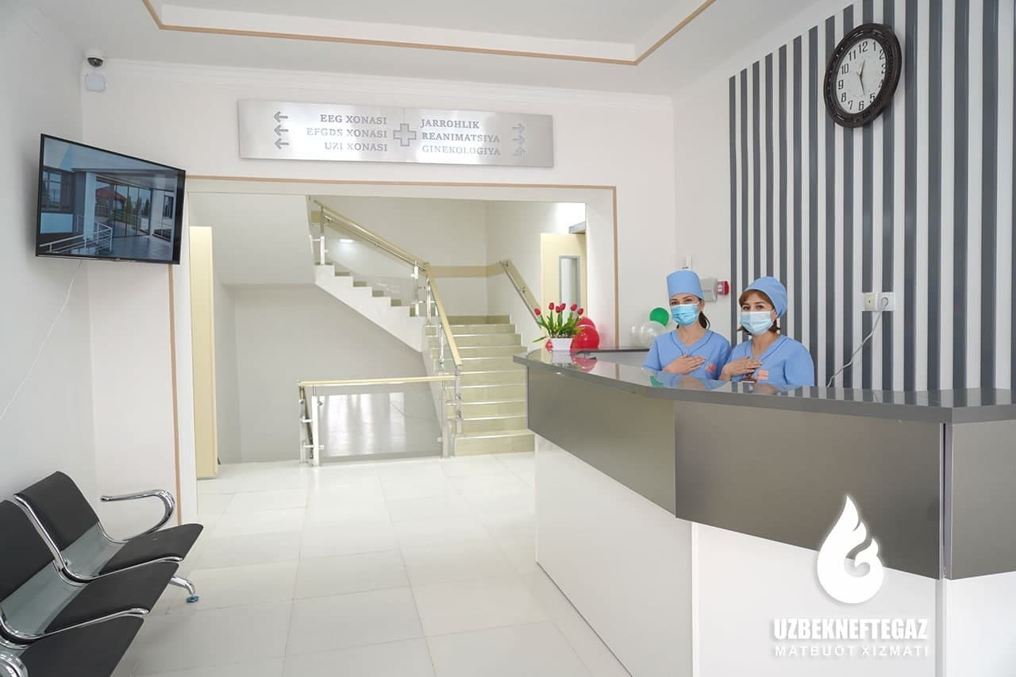
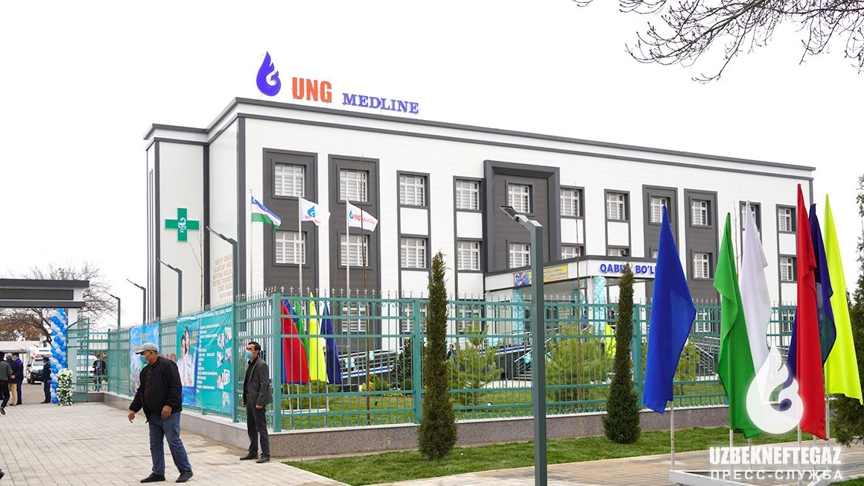
Ministry of Investment,
Industry and Trade of the Republic of Uzbekistan
We invite to invest in Privatization of LLC “UNG Medline”
Project overview
Location
Kashkadarya region
Population | 3,6 million
Tashkent region
Elderly Population (60+ years) | 8%
HDI | 0,730
Kashkadarya Region
Competitive landscape
Limited modern healthcare facilities in Kashkadarya.
The project will address 10-15% of regional healthcare demand by 2027.
NPV
$0.8 million
IRR
14%
PI
1.10
PP
5.5 years

