Slide 1
Ministry of Investment,
Industry and Trade of the Republic of Uzbekistan
Privatization of LLC “SAMARKAND AGROMUZ”
Project overview
Business model:
Majority ownership transfer via public auction. The enterprise operates on 8 ha, processing and storing agricultural products.
Project scope
Privatization of 97.1% shares of LLC “SAMARKAND AGROMUZ”, a subsidiary of JSC “Agrobank”, specializing in agricultural processing and storage
Investment terms:
Investor will acquire 97.1% ownership via public auction.
Timeline
2025
2026
Transfer of ownership to the investor
Public auction announcement and bidding process
Financing (estimated value)
$4-7 million (subject to auction results)
Location
Samarkand district, Samarkand region
Advantages and Potential
Strategic location in a major agricultural and tourism hub.
High demand for processed agricultural products.
Potential for export to Central Asian markets.

Slide 2
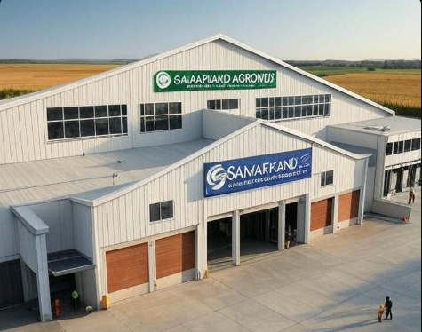
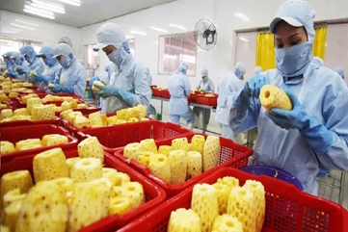
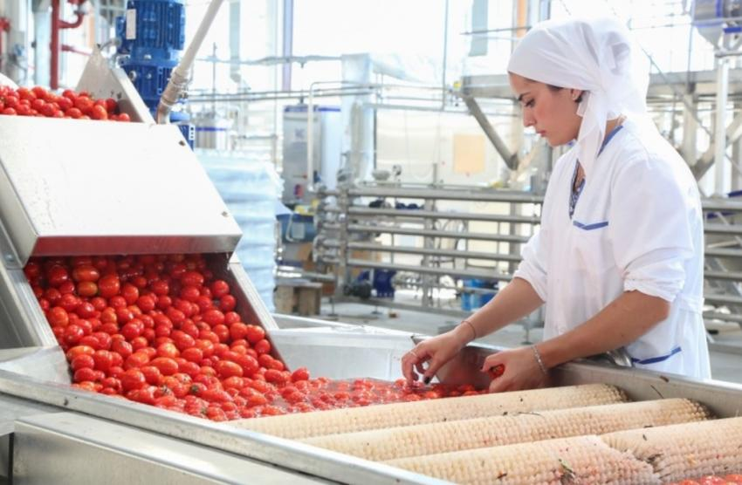
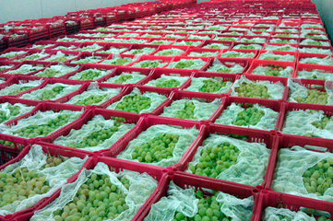
Ministry of Investment,
Industry and Trade of the Republic of Uzbekistan
We invite to invest in Privatization of LLC “SAMARKAND AGROMUZ”
Project overview
Location
Samarkand region
Population | 4,0 million
Tashkent region
Area | 16 773 km²
Agricultural Sector | 32,5%
Samarkand Region
Competitive landscape
Limited modern agro-processing facilities in Samarkand.
The project will capture 10-15% of regional agro-processing market by 2027.
NPV
$1 million
IRR
14.5%
PI
1.12
PP
5.3 years

