Slide 1

Ministry of Investment,
Industry and Trade
of the Republic of Uzbekistan
Privatization of LLC “Namangan Agro Logistics”
Project overview
Business model:
Near-full ownership transfer via public auction. The enterprise operates on 10 ha, providing cold storage and logistics for agricultural products.
Project scope
Privatization of 99.9% shares of LLC “Namangan Agro Logistics”, a subsidiary of JSC “Asakabank”, operating in agricultural logistics and storage
Investment terms:
Investor will acquire 99.9% ownership via public auction.
Timeline
2025
2026
Transfer of ownership to the investor
Auction preparation and public bidding
Financing (estimated value)
$5-8 million (subject to auction results)
Location
Pop district, Namangan region
Advantages and Potential
Strategic location in a key agricultural region.
High potential for export-oriented logistics services.
Opportunity to integrate modern storage technologies.

Slide 2
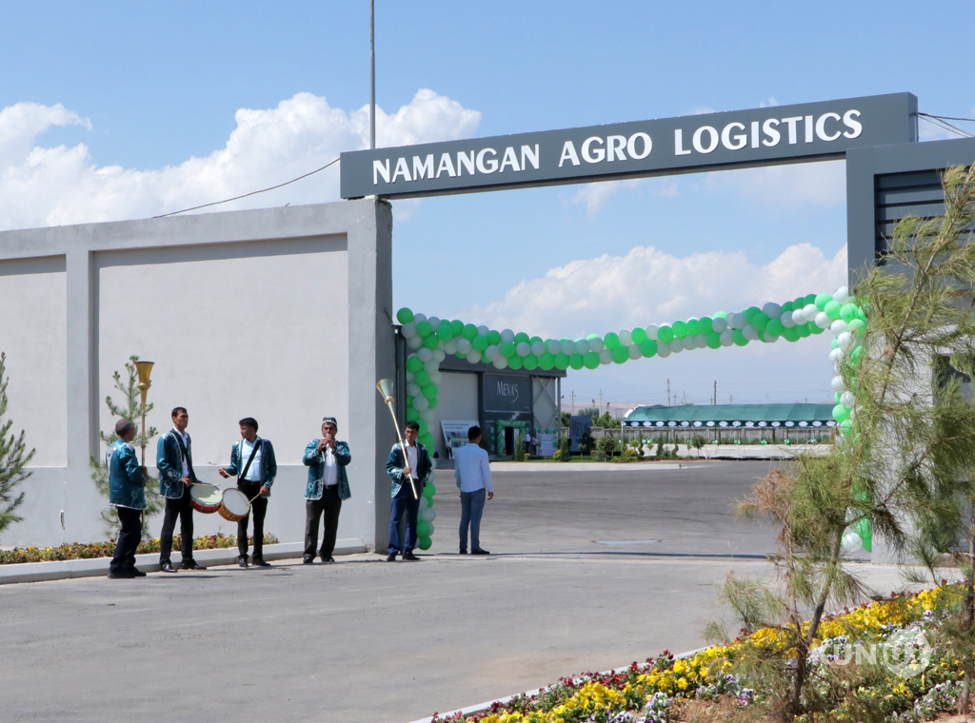
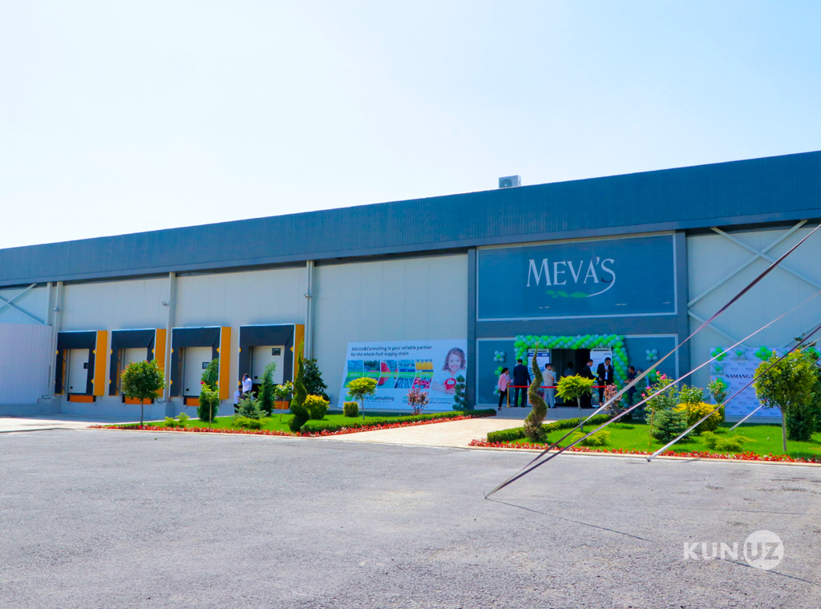

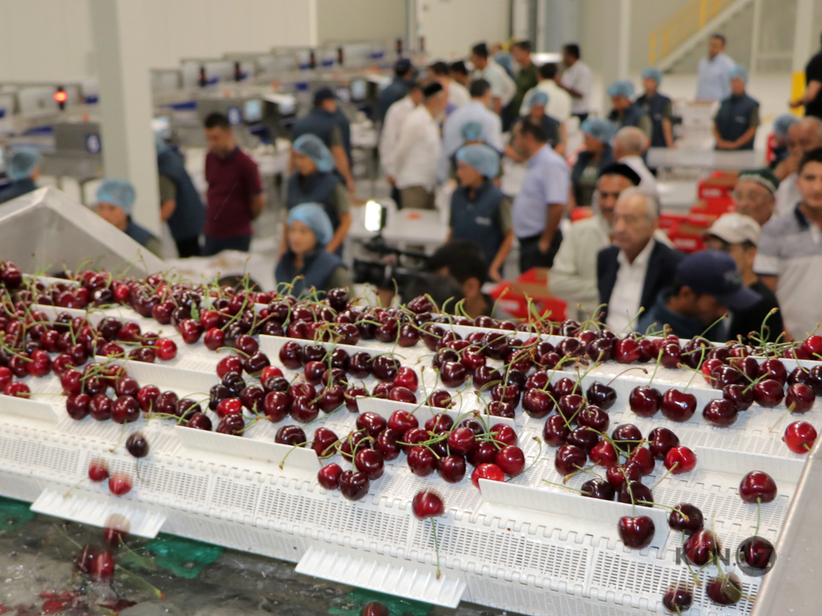
Ministry of Investment,
Industry and Trade
of the Republic of Uzbekistan
We invite to invest in Privatization of LLC “Namangan Agro Logistics”
Project overview
Location
Namangan region
Population | 3,1 million
Tashkent region
Area | 7,440 km²
Agricultural Sector | 30%
Namangan Region
Competitive landscape
Growing demand for agro-logistics in the Fergana Valley.
The project will capture 15-20% of regional agro-logistics market by 2027.
NPV
$1.2 million
IRR
15.5%
PI
1.18
PP
5.2 years

