Slide 1
Privatization of LLC “Auto Spring Components”
Ministry of Investment,
Industry and Trade of the Republic of Uzbekistan
Project overview
Business model:
Full ownership transfer via public auction. The enterprise operates on 3 ha of land, supplying components to Uzbekistan’s automotive industry.
Project scope
Privatization of 100% shares of LLC “Auto Spring Components”, a subsidiary of JSC “Uzavtosanoat”, producing automotive springs and components
Investment terms:
Investor will acquire 100% ownership via public auction.
Timeline
2025
2026
Ownership transfer to the investor
Auction preparation and public bidding
Financing
$7 million (subject to auction results)
Location
Andijan region
Advantages and Potential
Strong demand from JSC “Uzavtosanoat and export markets.
Potential for technological upgrades and production expansion.
Strategic location in Andijan, a manufacturing hub.

Slide 2
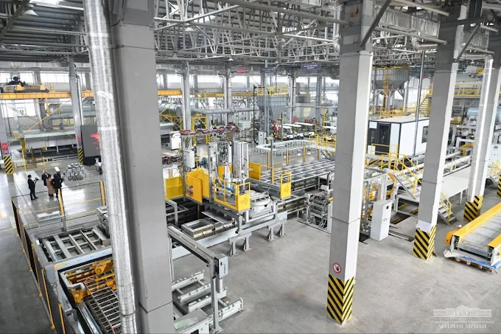
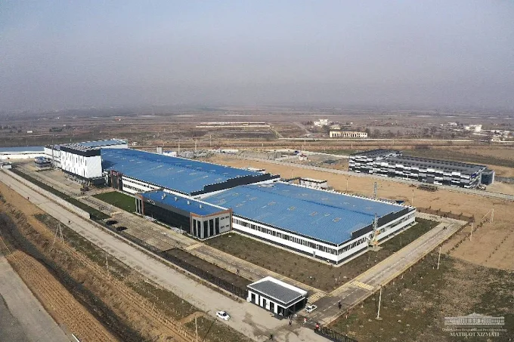
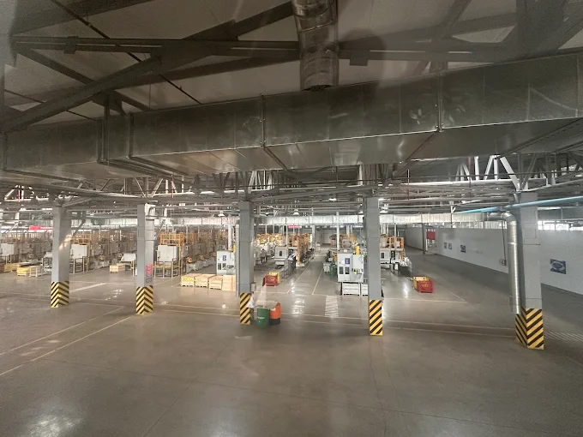
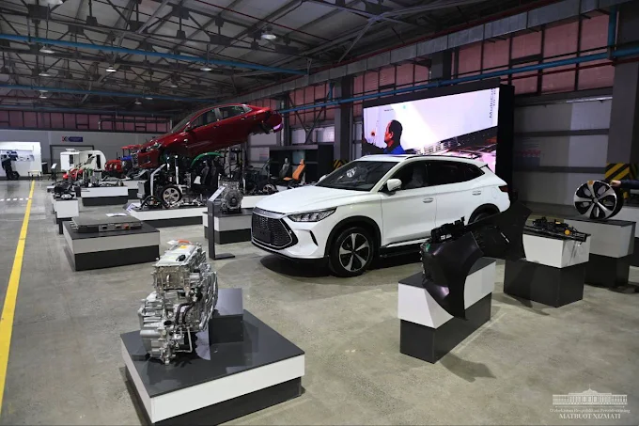
Ministry of Investment,
Industry and Trade of the Republic of Uzbekistan
We invite to invest in Privatization of LLC “Auto Spring Components”
Project overview
Location
Andijan region
Population | 3,3 million
Tashkent region
Area | 4 300 km²
Industry | 22.3% of GRP
Andijan Region
Competitive landscape
Growing automotive sector with limited local component suppliers.
The project will capture 10-15% of Uzbekistan’s automotive parts market by 2027.
NPV
$2 million
IRR
16%
PI
1.20
PP
4.8 years

