Slide 1
Ministry of Investment,
Industry and Trade of the Republic of Uzbekistan
Privatization of LLC “Andijan Mechanical Enterprise”
Project overview
Business model:
Full ownership transfer through public auction. The enterprise operates on 5 ha of land, providing maintenance services for railway equipment.
Project scope
Privatization of 100% shares of LLC “Andijan Mechanical Enterprise”, a subsidiary of JSC “Uzbekistan Railways”, specializing in mechanical engineering and equipment maintenance
Investment terms:
Investor will acquire 100% ownership via public auction.
Timeline
2025
2026
Transfer of ownership to the investor
Public auction announcement and bidding process
Financing
$10 million (subject to auction results)
Location
Fergana region
Advantages and Potential
Strategic location in the Fergana Valley, a key industrial hub.
High demand for railway equipment maintenance in Uzbekistan.
Potential for modernization and export-oriented services.

Slide 2
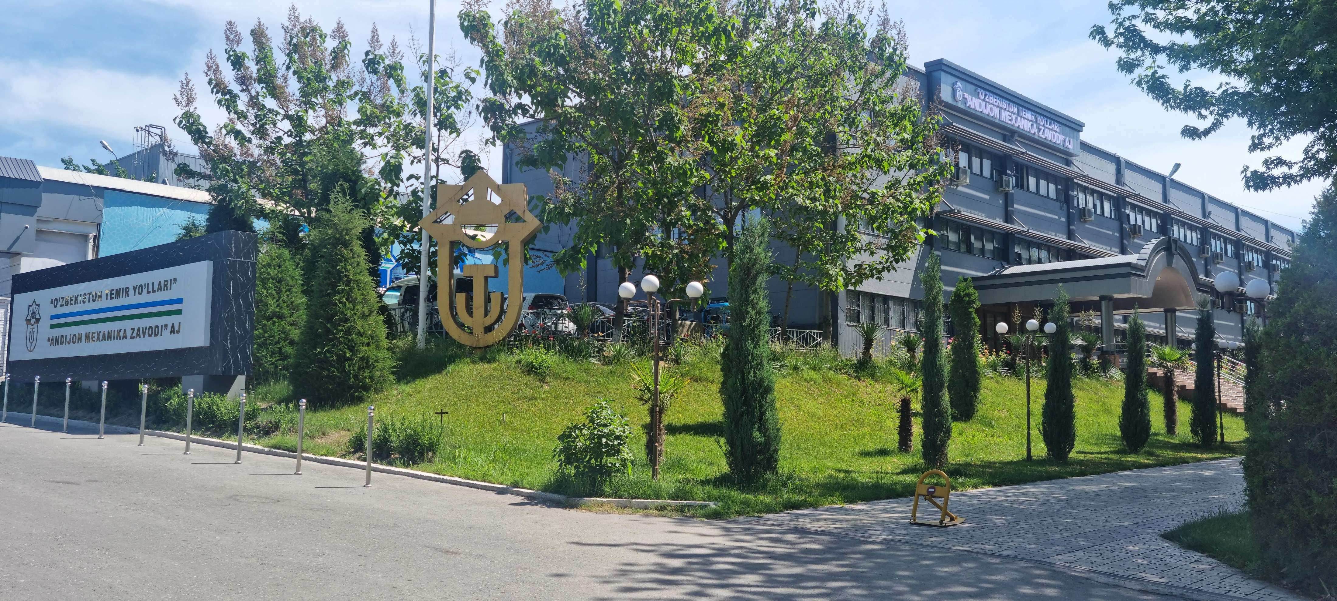
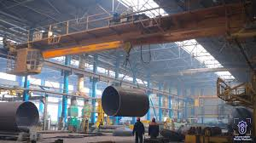
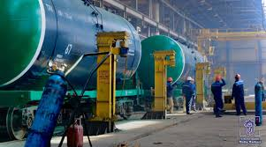
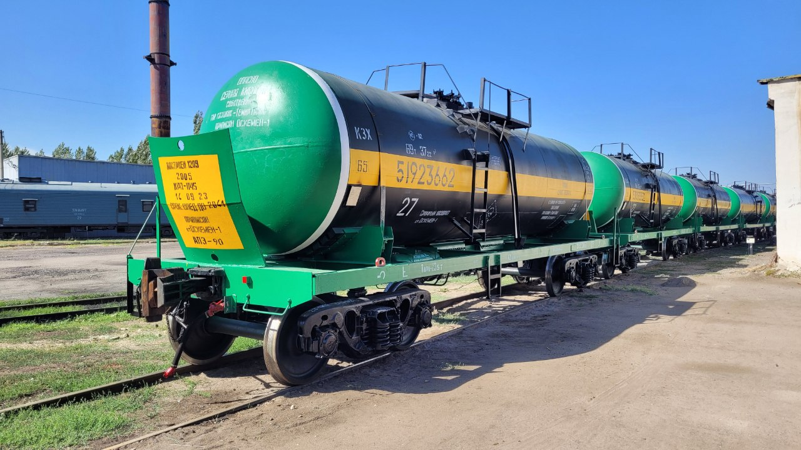
Ministry of Investment,
Industry and Trade of the Republic of Uzbekistan
We invite to invest in Privatization of LLC “Andijan Mechanical Enterprise”
Project overview
Location
Andijan region
Population | 3,3 million
Tashkent region
Area | 4 300 km²
Industry | 22.3% of GRP
Andijan Region
Competitive landscape
Limited specialized mechanical enterprises in Andijan.
The project will capture 15-20% of regional railway maintenance market by 2027.
NPV
$1.5 million
IRR
15%
PI
1.15
PP
5 years

