Slide 1

Ministry of Investment,
Industry and Trade
of the Republic of Uzbekistan
Modernization of Water Supply System in Surkhandarya Region
Project overview
Business model:
PPP with private operation of water supply systems under a concession agreement on 100 ha of allocated land. Investors will manage infrastructure and revenue.
Project scope
Upgrading water supply and sewage systems to provide clean water and improve sanitation
Investment terms:
Investor will operate and manage the water supply system under a PPP concession agreement for 20-25 years.
Timeline
2025
2026
Completion of modernization and operational launch
Tender announcement and contractor selection
Financing
$1 100 million
Location
Surkhandarya Region
Advantages and Potential
Critical social impact addressing water scarcity.
High demand for clean water in the region.
Potential to expand to other regions.

Slide 2
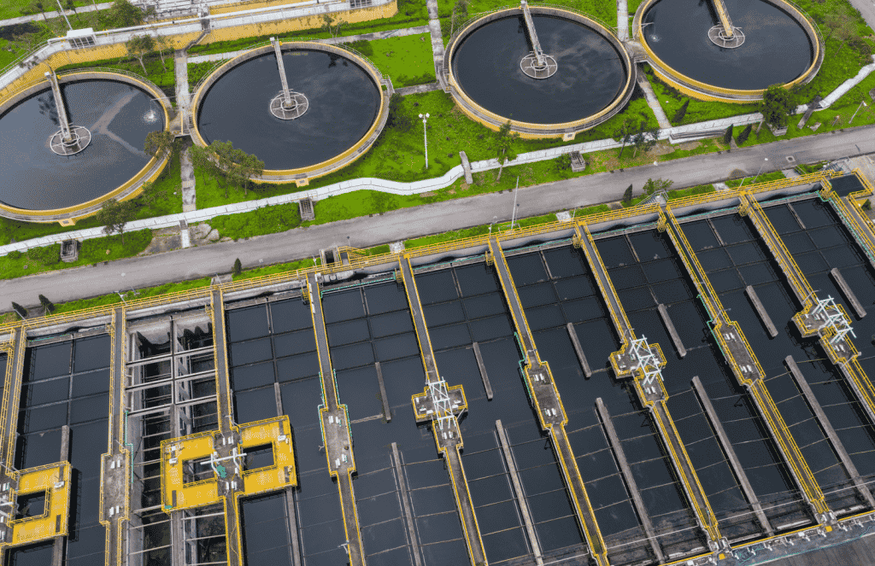
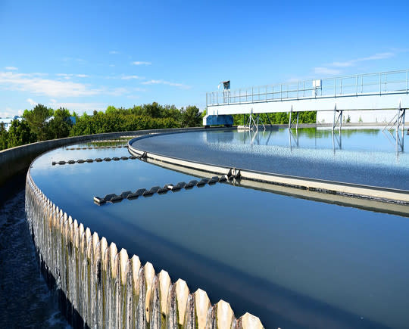
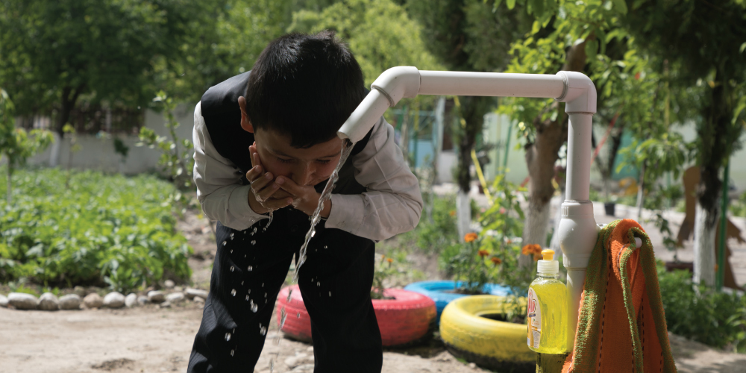
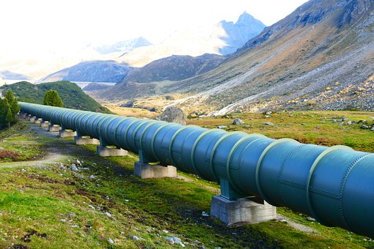
Ministry of Investment,
Industry and Trade
of the Republic of Uzbekistan
We invite to invest in Modernization of Water Supply System in Surkhandarya Region
Project overview
Location
Surkhandarya region
Population | 2,9 million
Tashkent region
Size | 20 800 km²
Water Access | 84%
Surkhandarya Region
Competitive landscape
Current water supply systems are outdated, with high demand for modernization.
The project will address 30% of regional water supply needs by 2027.
NPV
$120 million
IRR
20%
PI
1.90
PP
4.2 years

