Slide 1
Ministry of Investment,
Industry and Trade of the Republic of Uzbekistan
Modernization of Pump Stations in Namangan Region
Project overview
Business model:
PPP with private management of pump stations under a concession agreement on 25 ha of allocated land. Investors will manage infrastructure and revenue.
Project scope
Modernization of 28 irrigation pump stations to enhance agricultural productivity
Investment terms:
Investor will operate and manage the pump stations under a PPP concession agreement for 20-25 years.
Timeline
2025
2026
Completion of modernization and operational launch
Tender announcement and contractor selection
Financing
$125 million
Location
Namangan region
Advantages and Potential
High economic impact supporting agriculture.
Moderate investment with quick implementation.
Innovative energy-efficient pump technologies.

Slide 2
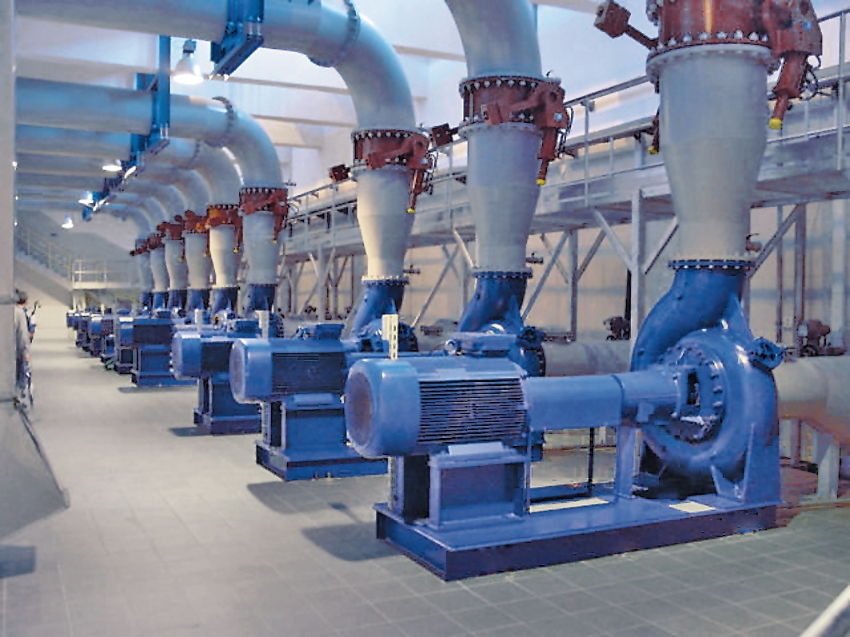
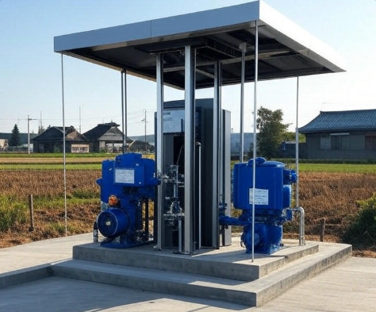
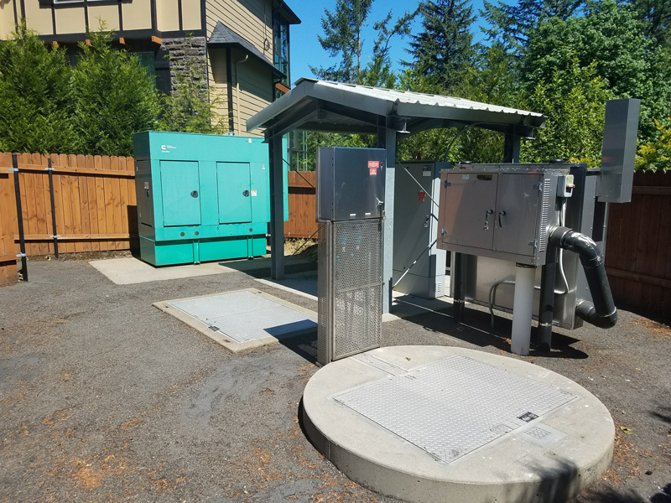
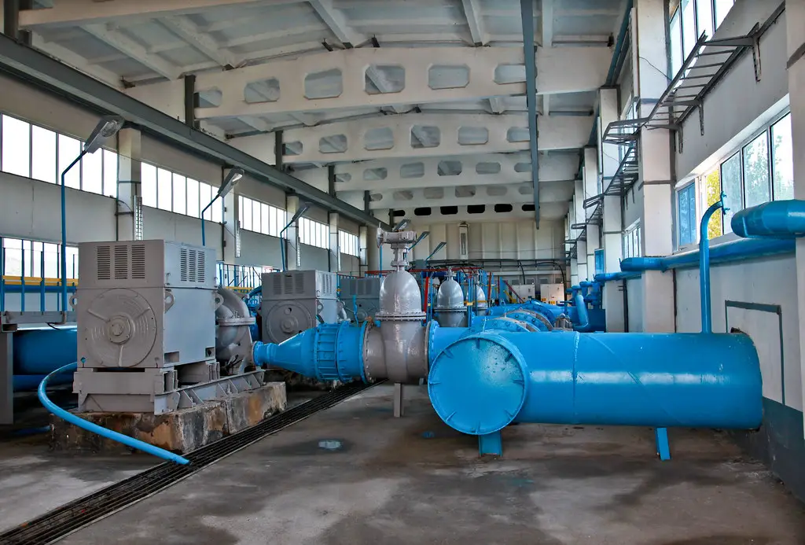
Ministry of Investment,
Industry and Trade of the Republic of Uzbekistan
We invite to invest in Modernization of Pump Stations in Namangan Region
Project overview
Location
Namangan region
Area | 7 440 km²
Population | 3,1 million
Namangan city
Competitive landscape
Outdated irrigation systems limit agricultural output.
The project will enhance 20% of regional irrigation capacity by 2027.
NPV
$25 million
IRR
18.5%
PI
1.60
PP
5.2 years

