Slide 1

Ministry of Investment,
Industry and Trade
of the Republic of Uzbekistan
Construction of Tashkent — Andijan Toll Highway
Project overview
Business model:
PPP with private operation under a concession agreement. Investors will manage toll collection and infrastructure maintenance on 320 ha of allocated land
Project scope
Construction of a 303-km toll highway connecting Tashkent and Andijan to boost trade and logistics in the Fergana Valley.
Investment terms:
Investor will operate and manage the highway under a PPP concession agreement for 25-30 years.
Timeline
2025
2030
Full operational launch
Project concept development and tender preparation
Financing
$4 280 million
Location
Tashkent, Namangan, Fergana, and Andijan regions
Advantages and Potential
High social and economic impact for densely populated regions.
Strategic importance for trade and logistics development
Potential to serve as a key corridor in Central Asia

Slide 2
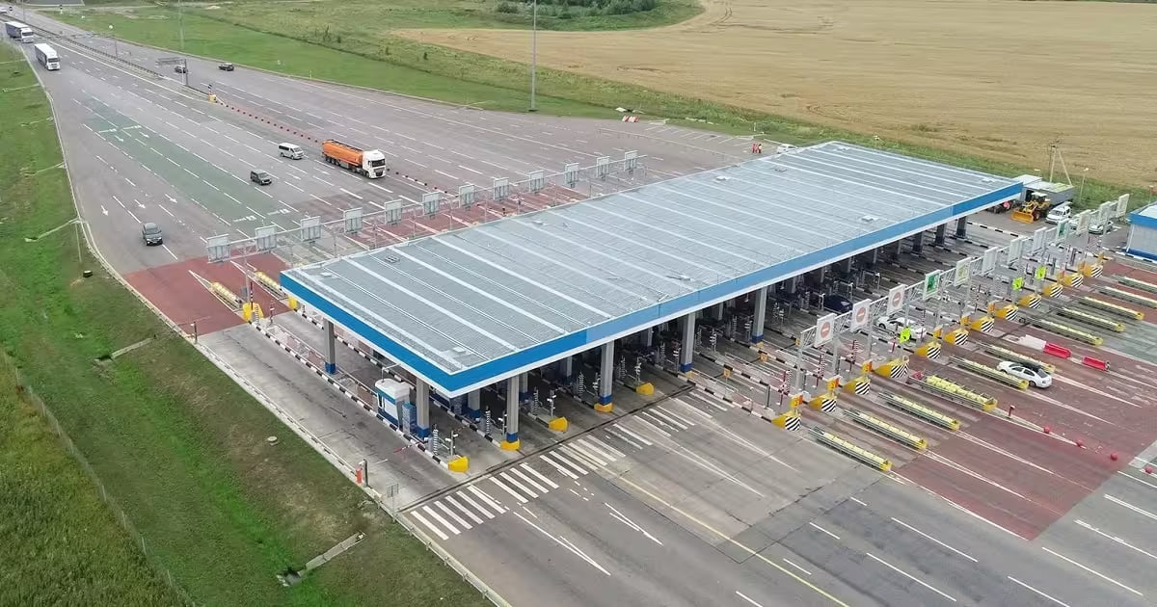
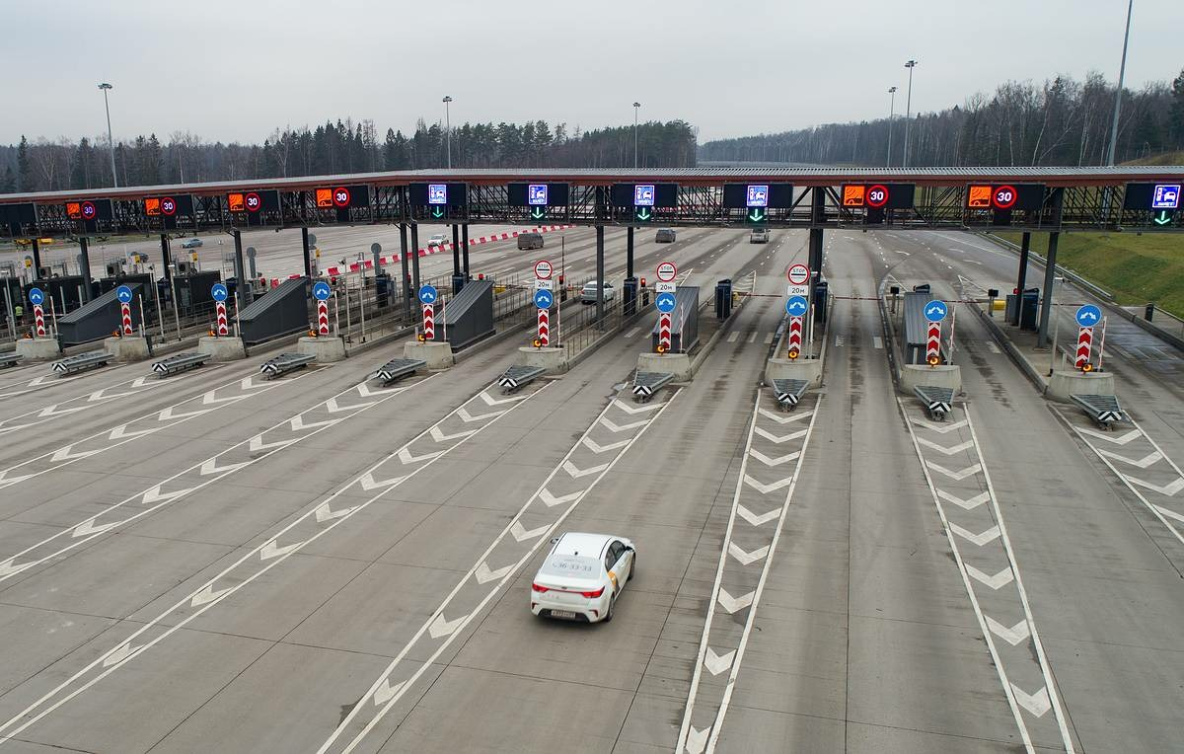
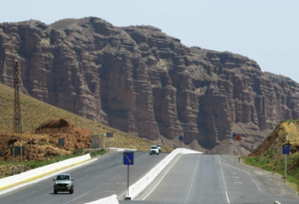
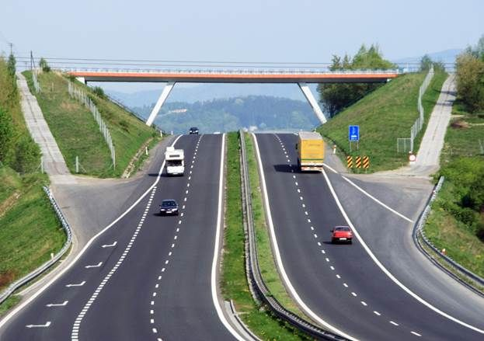
Ministry of Investment,
Industry and Trade
of the Republic of Uzbekistan
We invite to invest in Construction of Tashkent — Andijan Toll Highway
Project overview
Location
Tashkent region
Population | 3,2 million
Namangan Region
Namangan region
Population | 3,1 million
Tashkent Region
Fergana region
Population | 3,8 million
Andijan region
Population | 3,3 million
Andijan Region
Fergana Region
Competitive landscape
Limited high-capacity highways in the Fergana Valley.
The project will capture 12-15% of regional logistics market share by 2032.
NPV
$900 million
IRR
28%
PI
2.50
PP
3.6 years

