Slide 1
Ministry of Investment,
Industry and Trade of the Republic of Uzbekistan
Construction of a Multidisciplinary Hospital in Fergana Region
Project overview
Business model:
PPP with private operation of the hospital under a concession agreement on 15 ha of allocated land. Investors will manage healthcare services and revenue.
Project scope
Construction of an 800-bed multidisciplinary hospital equipped with advanced medical technologies
Investment terms:
Investor will operate and manage the hospital under a PPP concession agreement for 20-25 years.
Timeline
2025
2026
Completion of construction and operational launch
Project design and tender announcement
Financing
$306 million
Location
Fergana region
Advantages and Potential
High social impact improving healthcare access.
Stable demand for medical services in a densely populated region.
Innovative medical technologies attracting private investment.

Slide 2
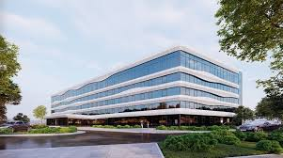
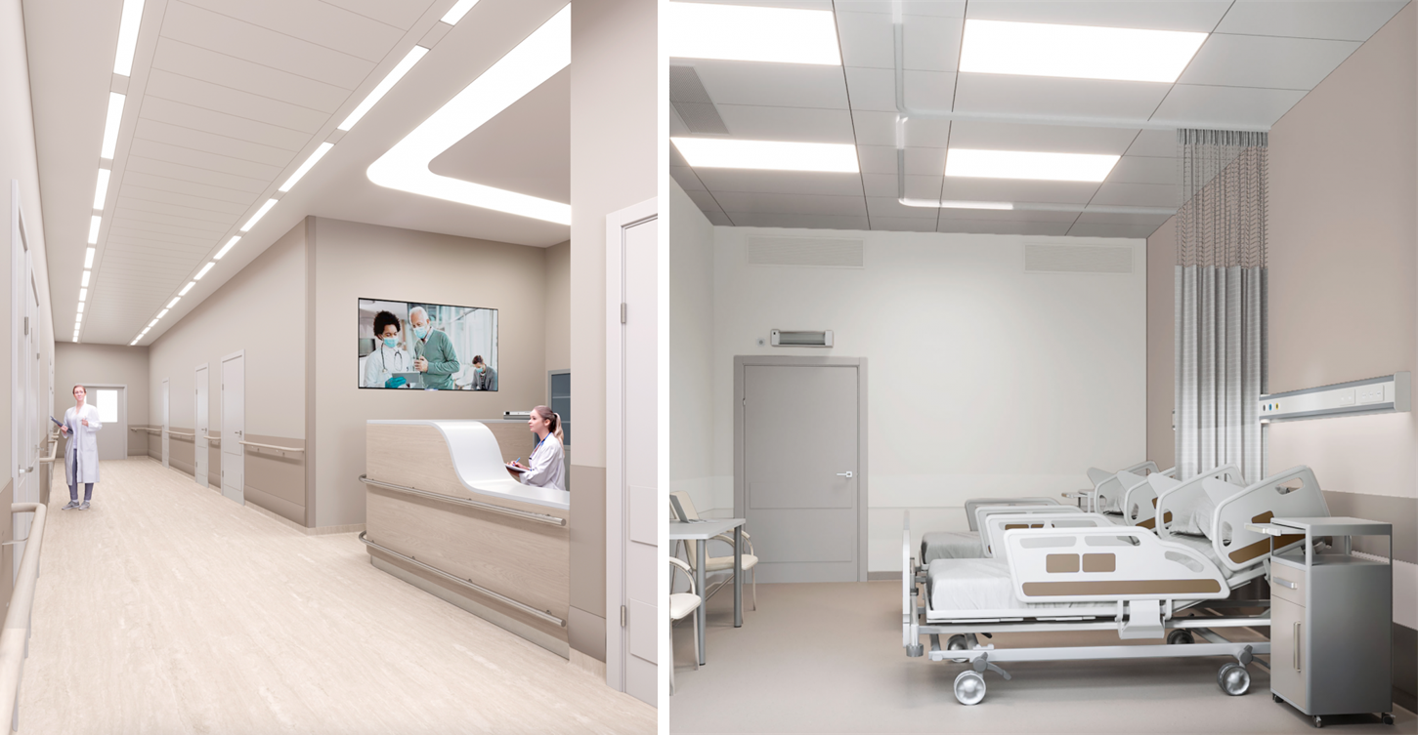
Ministry of Investment,
Industry and Trade of the Republic of Uzbekistan
We invite to invest in Construction of a Multidisciplinary Hospital in Fergana Region
Project overview
Location
Fergana region
Population | 3,8 million
Tashkent region
Size | 7 001 km²
HDI | 0.740
Fergana Region
Competitive landscape
Limited modern healthcare facilities in the Fergana Valley.
The project will address 25% of regional healthcare demand by 2027.
NPV
$50 million
IRR
18%
PI
1.60
PP
5 years

