Slide 1
Production of alkyl benzene
Ministry of Investment,
Industry and Trade of the Republic of Uzbekistan
Project overview
Financing
250 mln USD
Business model: manufacturing facility with production capacity 50 thsd. tons of alkyl benzene per year
Project scope
Construction of alkyl benzol
Production process for alkyl benzene
Incentives
Infrastructure development at state cost* (project cost exceeding 15 mln USD)
Across the Republic, 27 FEZs offer tax breaks on land, property, water and CIT.
(CIT - applied for investments over 3 mln USD)
Feedstock preparation
Alkylation reaction
Separation and purification
Recycling and byproduct management
Project description
Exemption from taxes
3 years if investment is between 0,3 – 3 mln USD
5 years if investment is between 3 – 5 mln USD
7 years if investment is between 5 – 10 mln USD
10 years if investment is over 10 mln USD
Domestic market
Existing 5 neighbor markets
Russia, Europe, Middle East markets
2 production lines
Capability to produce various grades and compositions
~160 employees
Trade volume of alkyl benzene (2024)
Infrastructure
Gas 12 cents/m³
Electricity 7 cents/kWh
Water 20 cents/m³
The volume of the alkyl benzene market in Uzbekistan was estimated at 5-6 mln of US dollars
Import
5,7 USD mln
Consumption (CA)
9 USD mln

Slide 2
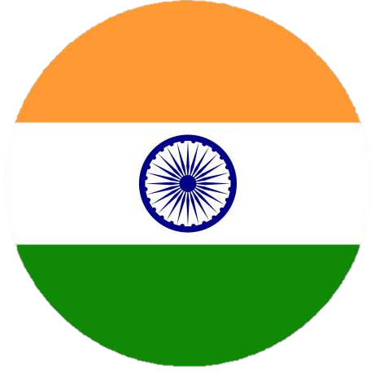
Ministry of Investment,
Industry and Trade of the Republic of Uzbekistan
We invite to invest in production of alkyl benzene in Uzbekistan
Project overview
Trade agreements
Competition: Uzbekistan offers highly competitive structure of operating costs for manufacturing of finished goods internationally
GSP+ agreement allows to export to EU at reduced or zero tariff for 6 200 products.
CIS Free Trade Agreement creates more integrated and open market with CIS countries.
Top-7 alkyl benzene exporters, USD bln
Average wage, USD ths per month
Average gas cost,
US cents per m³
India | 1,2 | n 0,4 | 30
Netherland | 0,8 | 3,5 | 40
Saudi Arabia | 0,6 | 2,9 | 6
Spain | 0,5 | 2,2 | 35
Japan | 0,5 | 3,0 | 55
Germany | 0,4 | 3,5 | 40
Belgium | 0,4 | 4,1 | 53
 | 0,0 | 0,4 | 12
Location
Kashkadarya region
Kashkadarya region
Size | 28 570 km²
Population | 3,08 mln
Uzbekistan
Availability of labor in oil & gas industry
Local ceramic products manufacturers can benefit from:
- Growing oil & gas sector
- Availability of skilled & unskilled labor
- Building on existing infrastructure and distribution networks
- Infrastructure development at state cost
- Incentives: Free economic zones offer tax breaks on land, CIT, water
Higher education institutions: 3
Faculties of higher education: 4
Number of graduates: 1 200

Slide 3
On the strategic international logistics corridor
Ministry of Investment,
Industry and Trade of the Republic of Uzbekistan
Tallin
Sankt-Peterburg
Riga
Latvia
Moscow
Klaipeda
Hamburg
Minsk
Berlin
Brest
Povorina
Essen
Lviv
Kyiv
Paris
Chop
Volgograd
Kandiagash
Aktogay
Astraxan
Beyney
Saksaulskaya
Ulan-Bator
Osh
Bayangal-Mangal
Mersin
Malatya
Saraxa
Mazar-i-Sharif
Kashgar
Xirat
Afghanistan
Peshavar
Iran
Pakistan
Bandar-e-Abbas
Chakhbahar
Karachi

Slide 4
Excellent air connectivity from Tashkent and other Uzbek airports
Ministry of Investment,
Industry and Trade of the Republic of Uzbekistan
New York
A visa-free policy for tourists from 90 countries
Diverse range of 59 carriers in Uzbekistan’s airport
11 airports across the Country, the main airports are Tashkent, Samarkand and Bukhara

